Slide 1
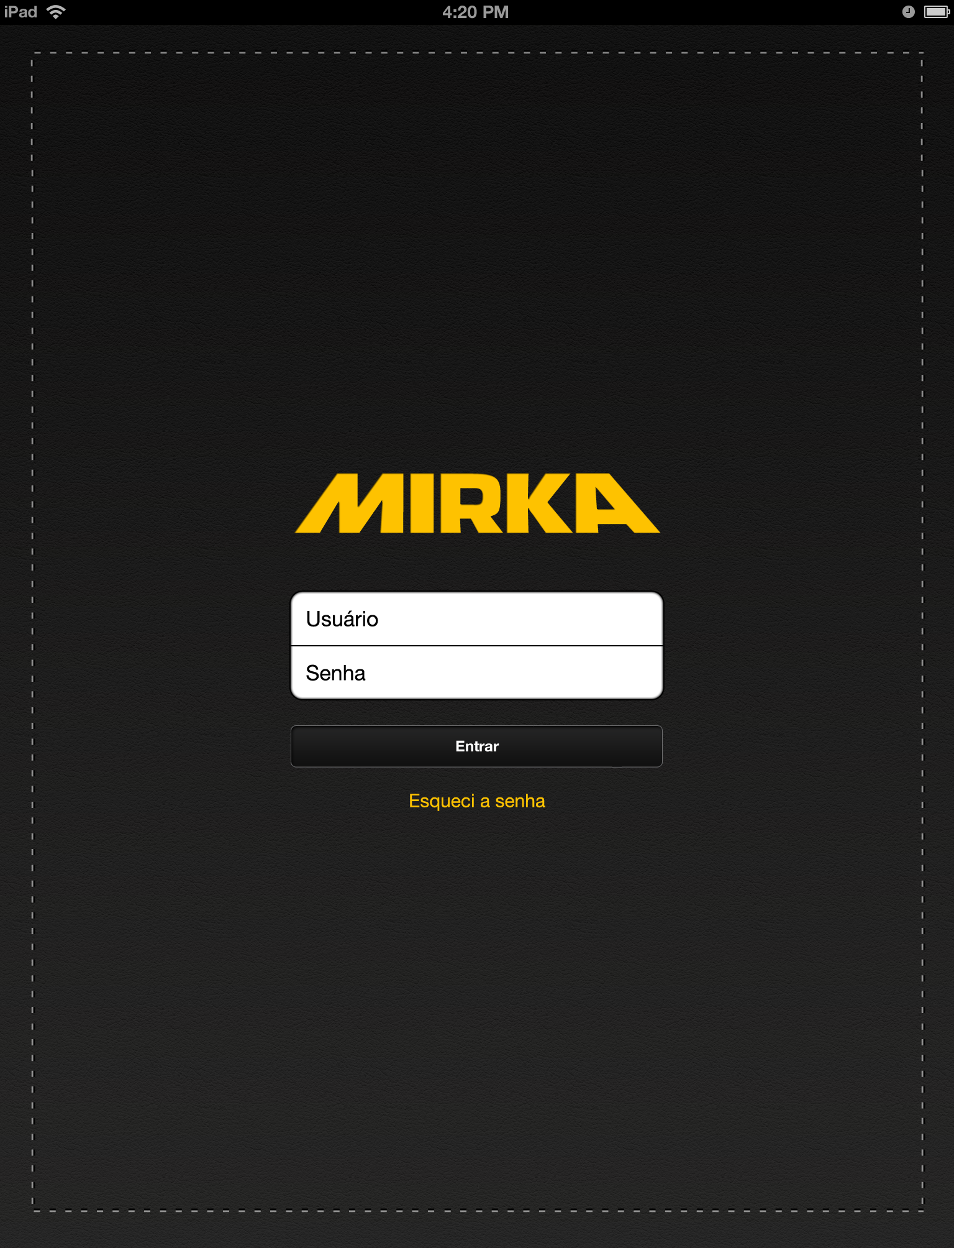
*Log in page
Verifies with backend
To log in user
PHASE 1
Takes you to *landing
page

Slide 2
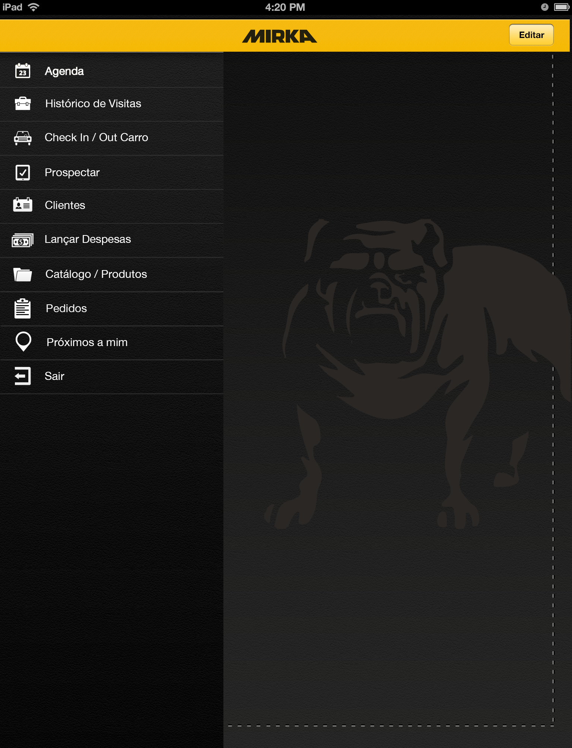

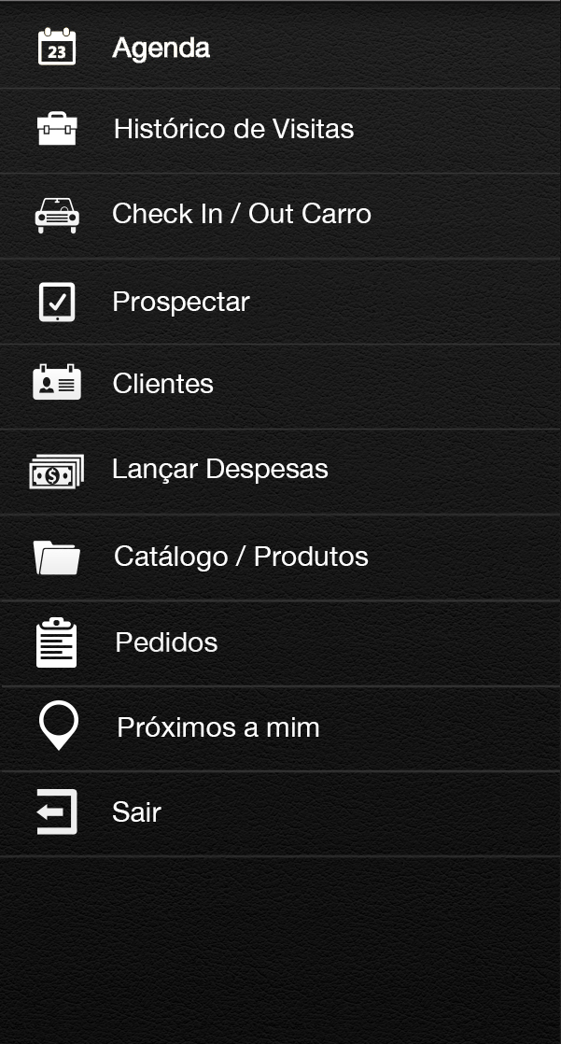
*Landing pages
Opens *Agenda Tab
Opens *Histórico de Visitas Tab
Opens *Check in / out Carro Tab
Opens *Prospectar Tab
Opens *Clientes Tab
Opens *Lançar Despesas Tab
Opens *Catálogo / Produtos Tab
Opens *Pedidos
Opens *Próximos a mim Tab
Exits back to *Login Page

Slide 3
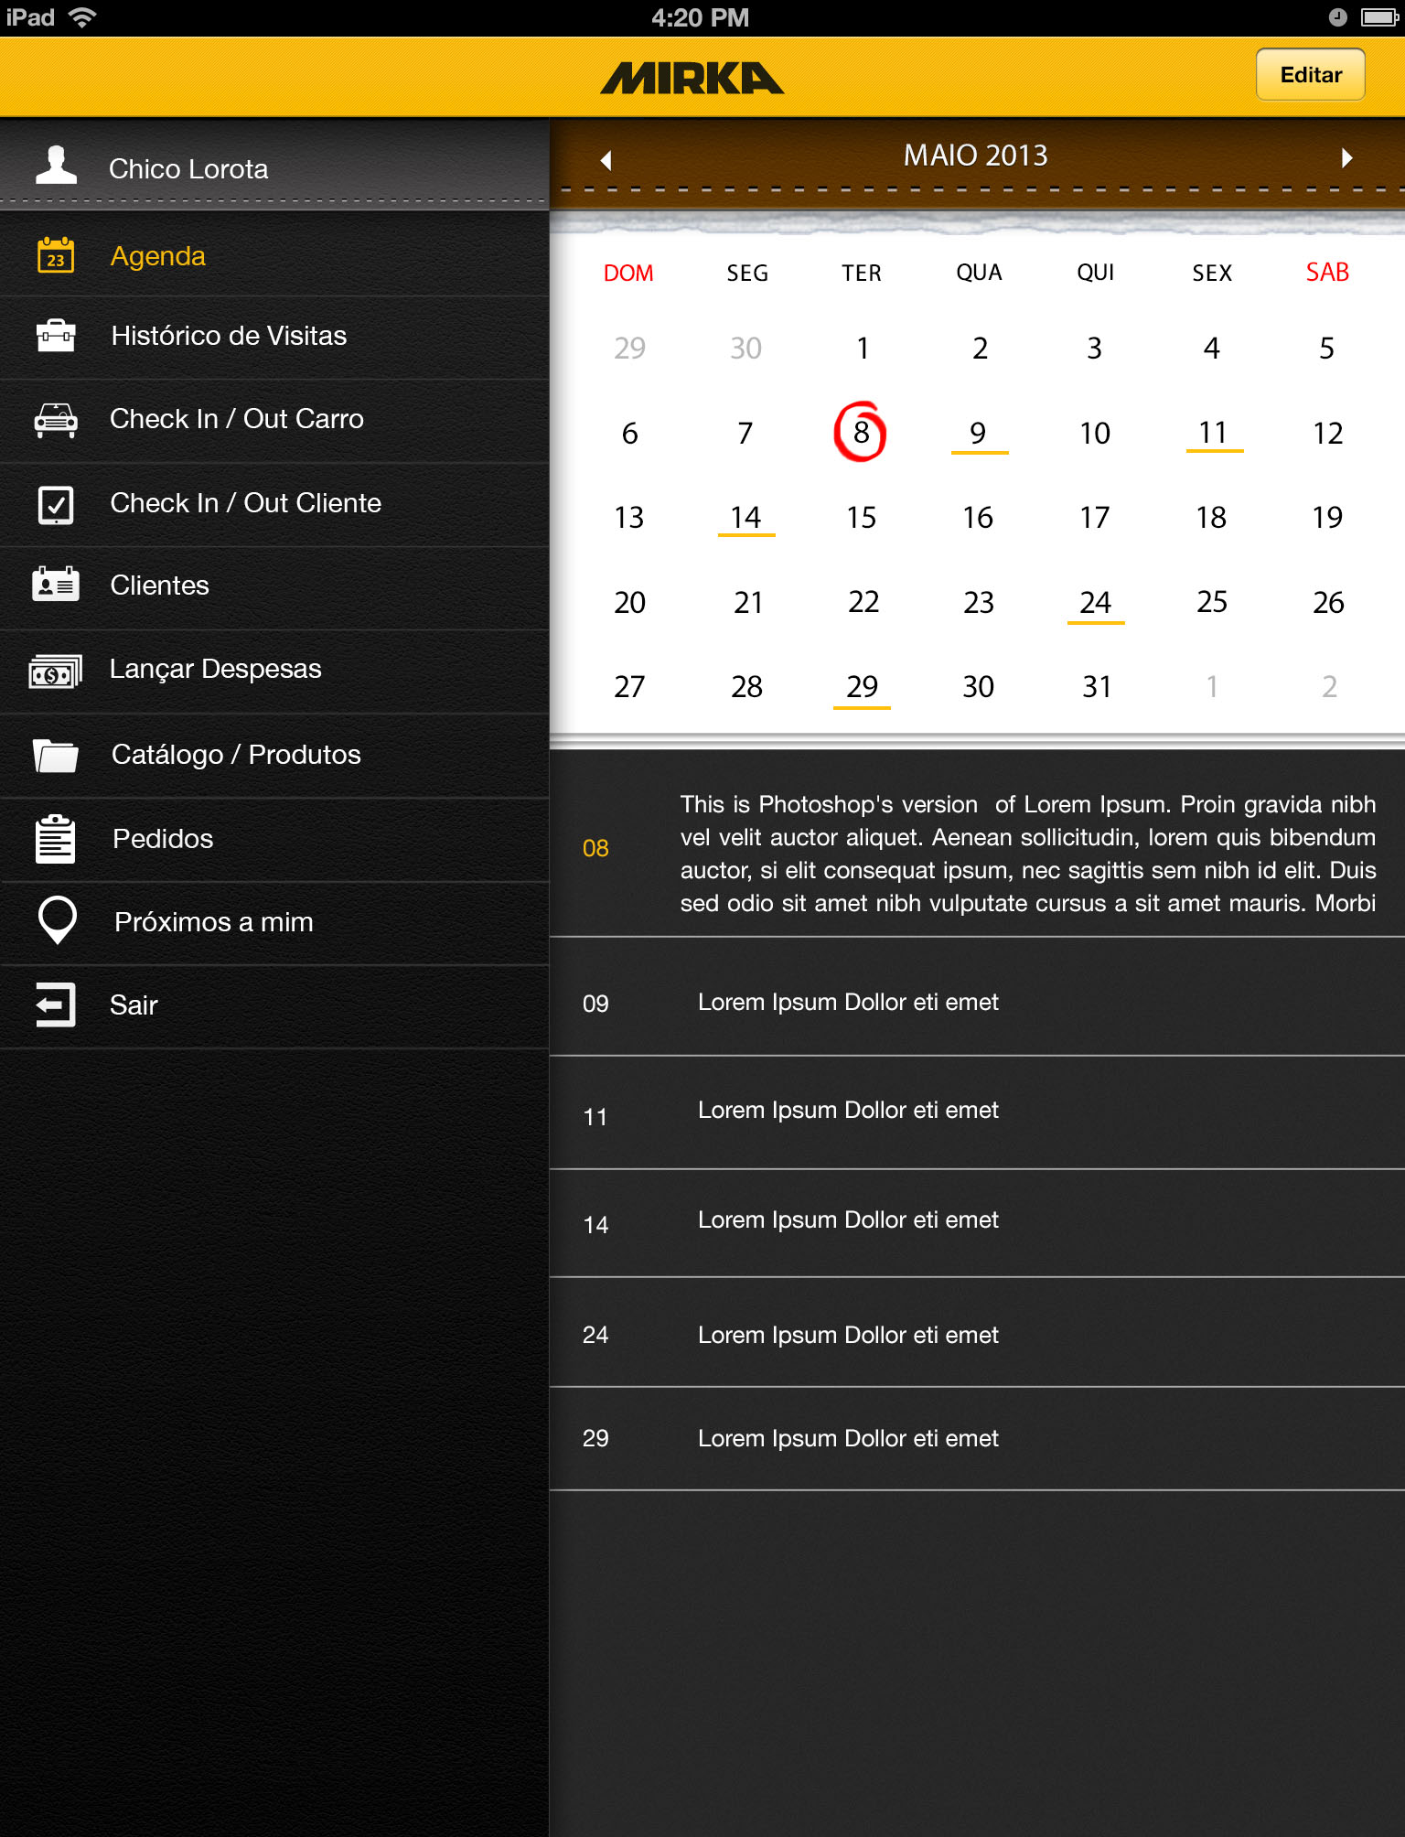

*Agenda Tab
Pulls client follow up dates and information from
Back end
When clicked displays Client name address
date and follow up description
When not clicked displays client name, address and
Date in a list

Slide 4
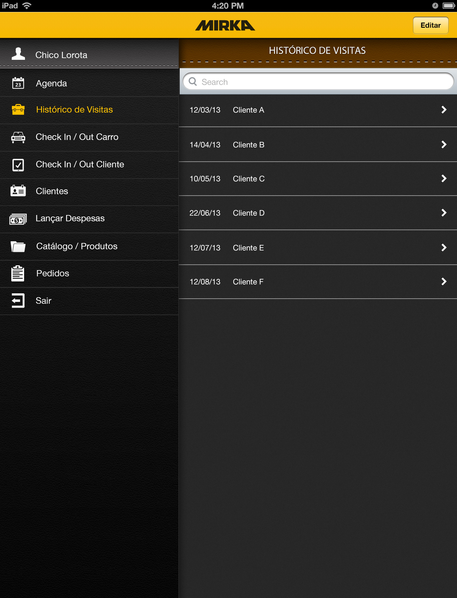
*Histórico de Visitas Tab
Pulls Visit history from backend “Date, client, visit type”
When clicked takes you to *Detalhes de Visitas type tab (this Tab displays varies based on type of visit)
Displays date, client name, and visit type
Detalhes de Visitas

Slide 5
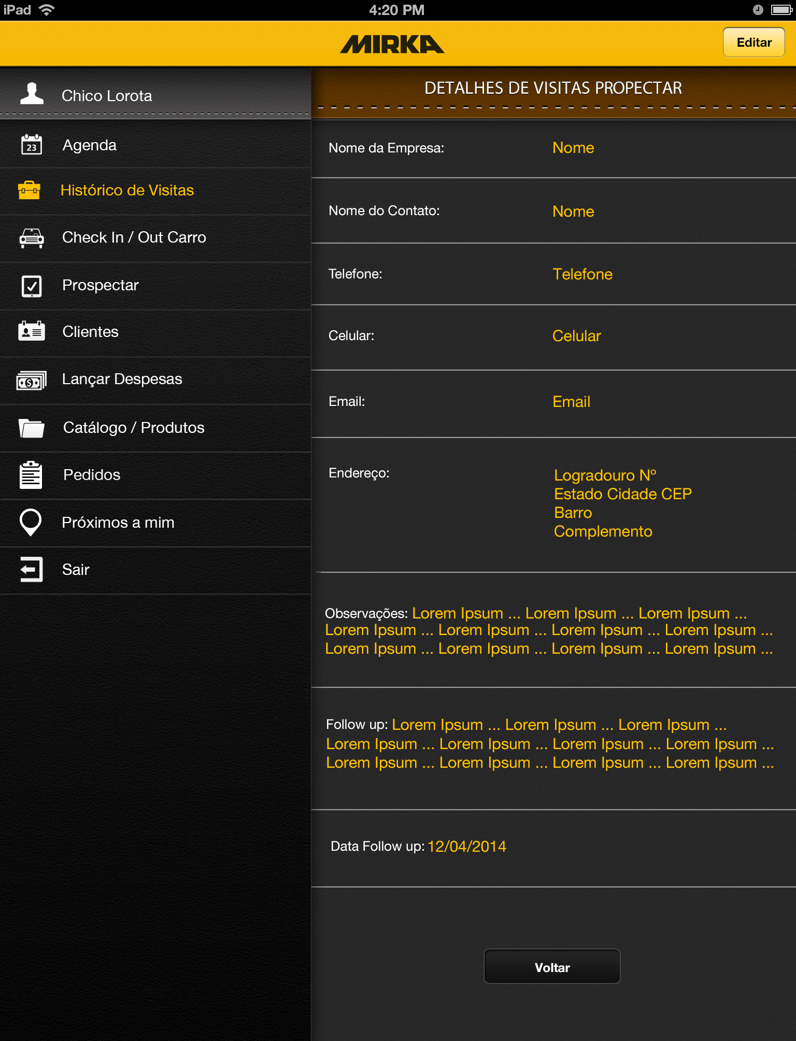
*Detalhes de Visitas Prospectar Tab
Read only, all fields are filled from
Back end database based on what was
Filled in on the *Prospectar tab

Slide 6
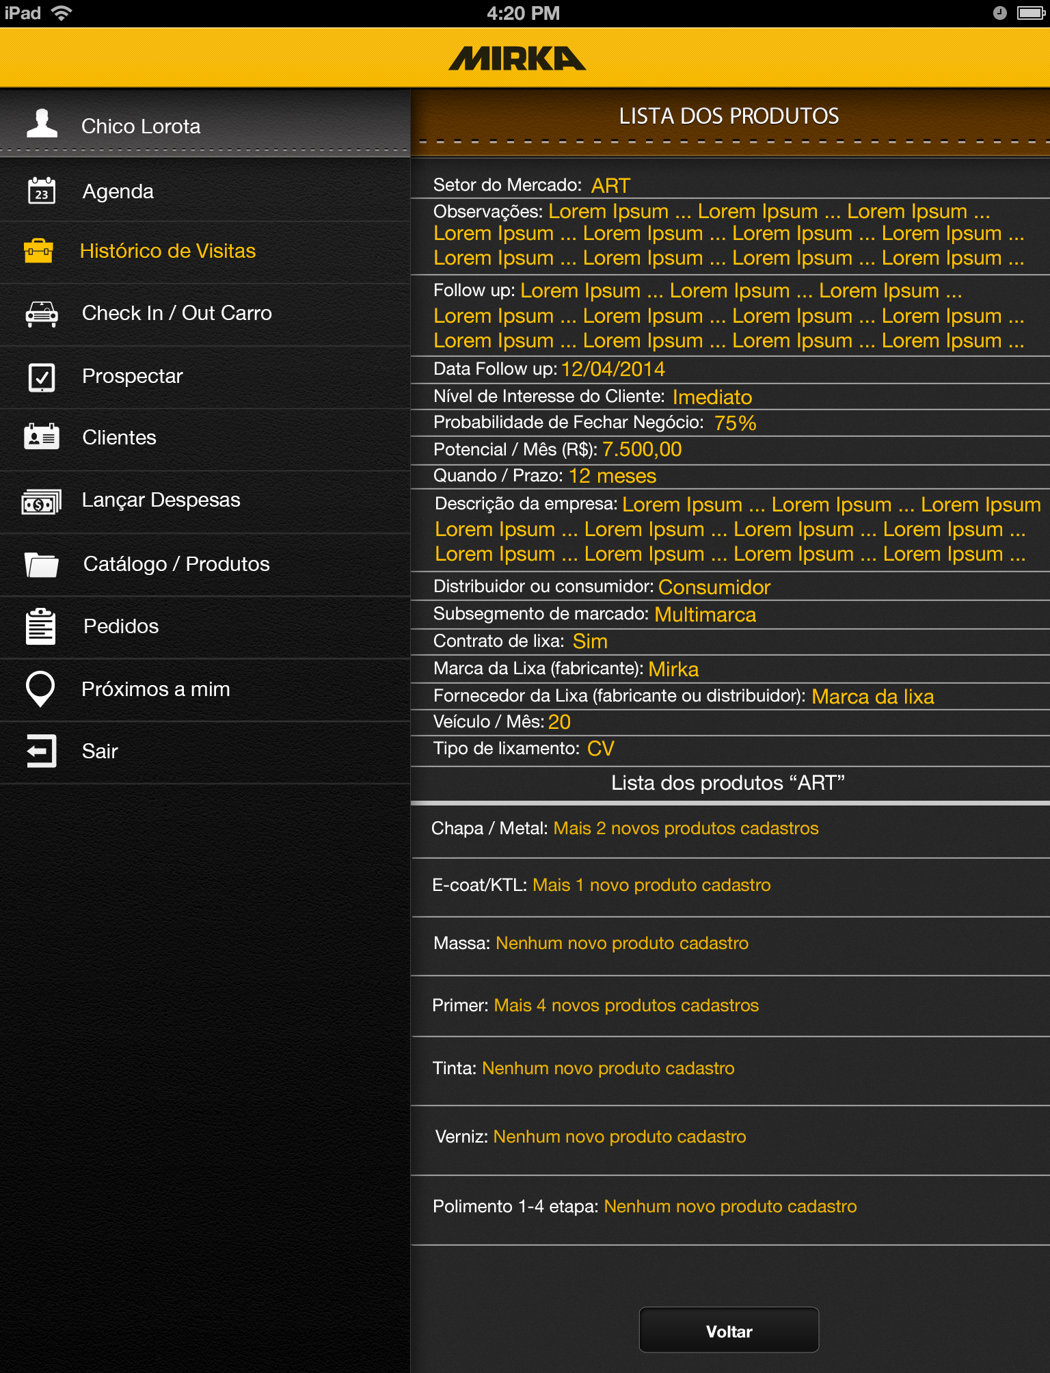
*Detalhes de Visitas Desenvolver Tab
Read only, all fields are filled from
Back end database based on what was
Filled in on the *Desenvolver tab
When products are added displays number equal to what was added
When one is added uses singular tense
When none are added uses nenhum

Slide 7
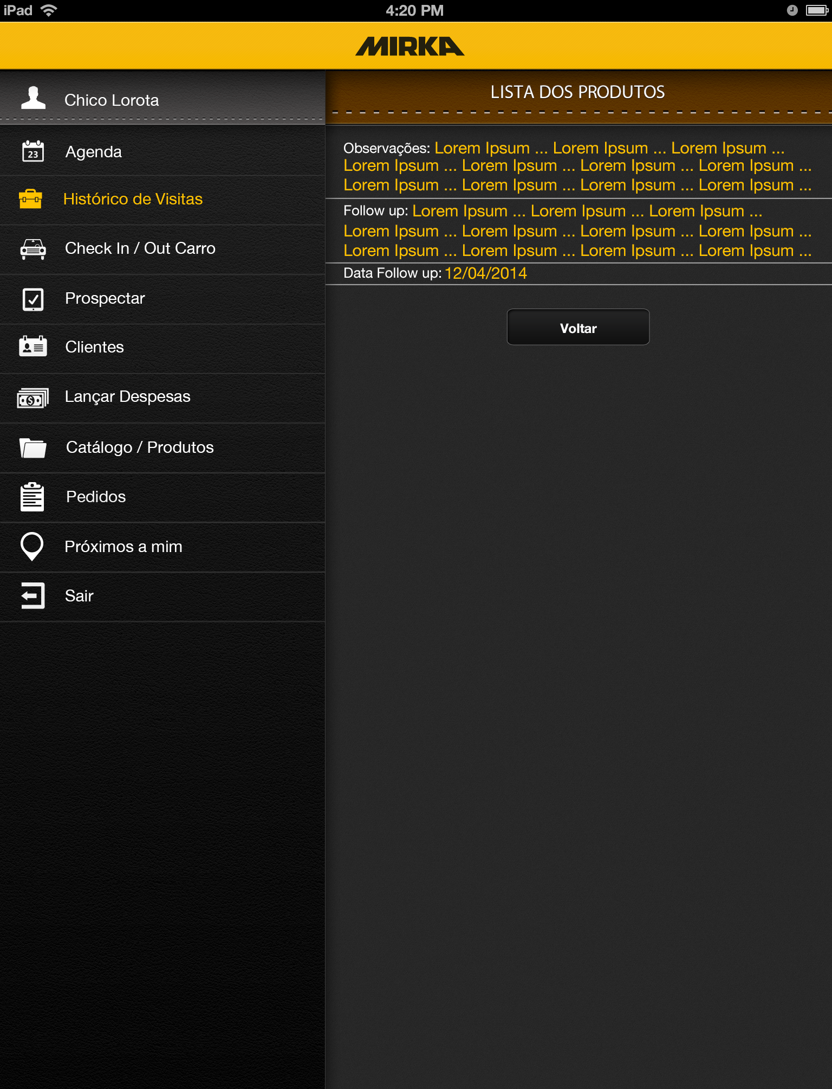
*Detalhes de Visitas Manutenção Tab
Read only, all fields are filled from
Back end database based on what was
Filled in on the *Manutenção tab

Slide 8
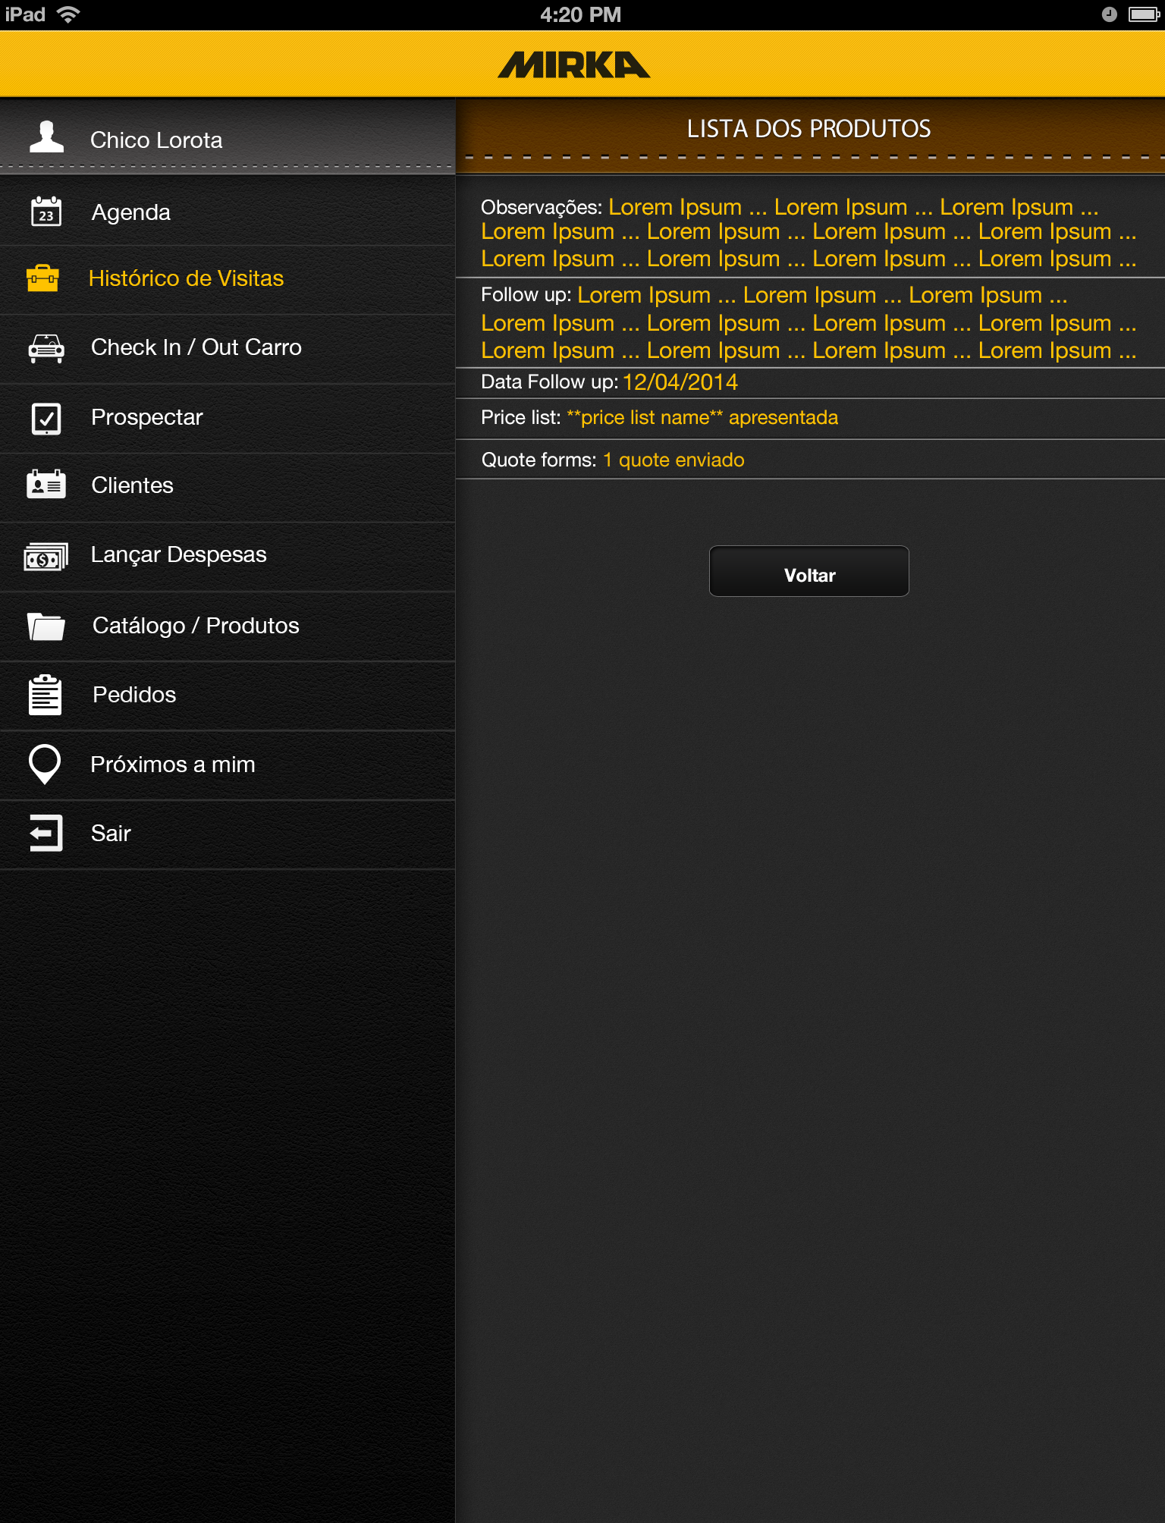
*Detalhes de Visitas Negociação Tab
Read only, all fields are filled from
Back end database based on what was
Filled in on the *Negociação tab
Displays the price list that was opened
During the visit pulls from back end
List number of quotes sent
Uses enviadas for more than 1
And nenhum for none

Slide 9
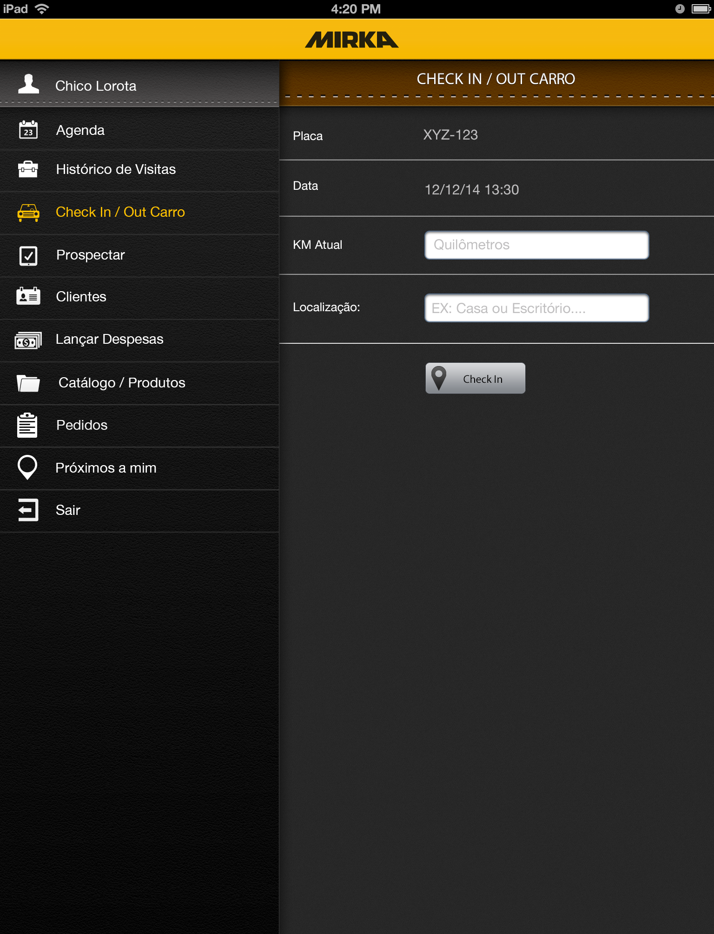
*Check in / out Carro “in” Tab
Pulls info from backend
Pulls info from backend
Open Text field
Open Text field
Takes you *Check in / out Carro “out”
Tab, Sends text field info to back end
PHASE 1

Slide 10
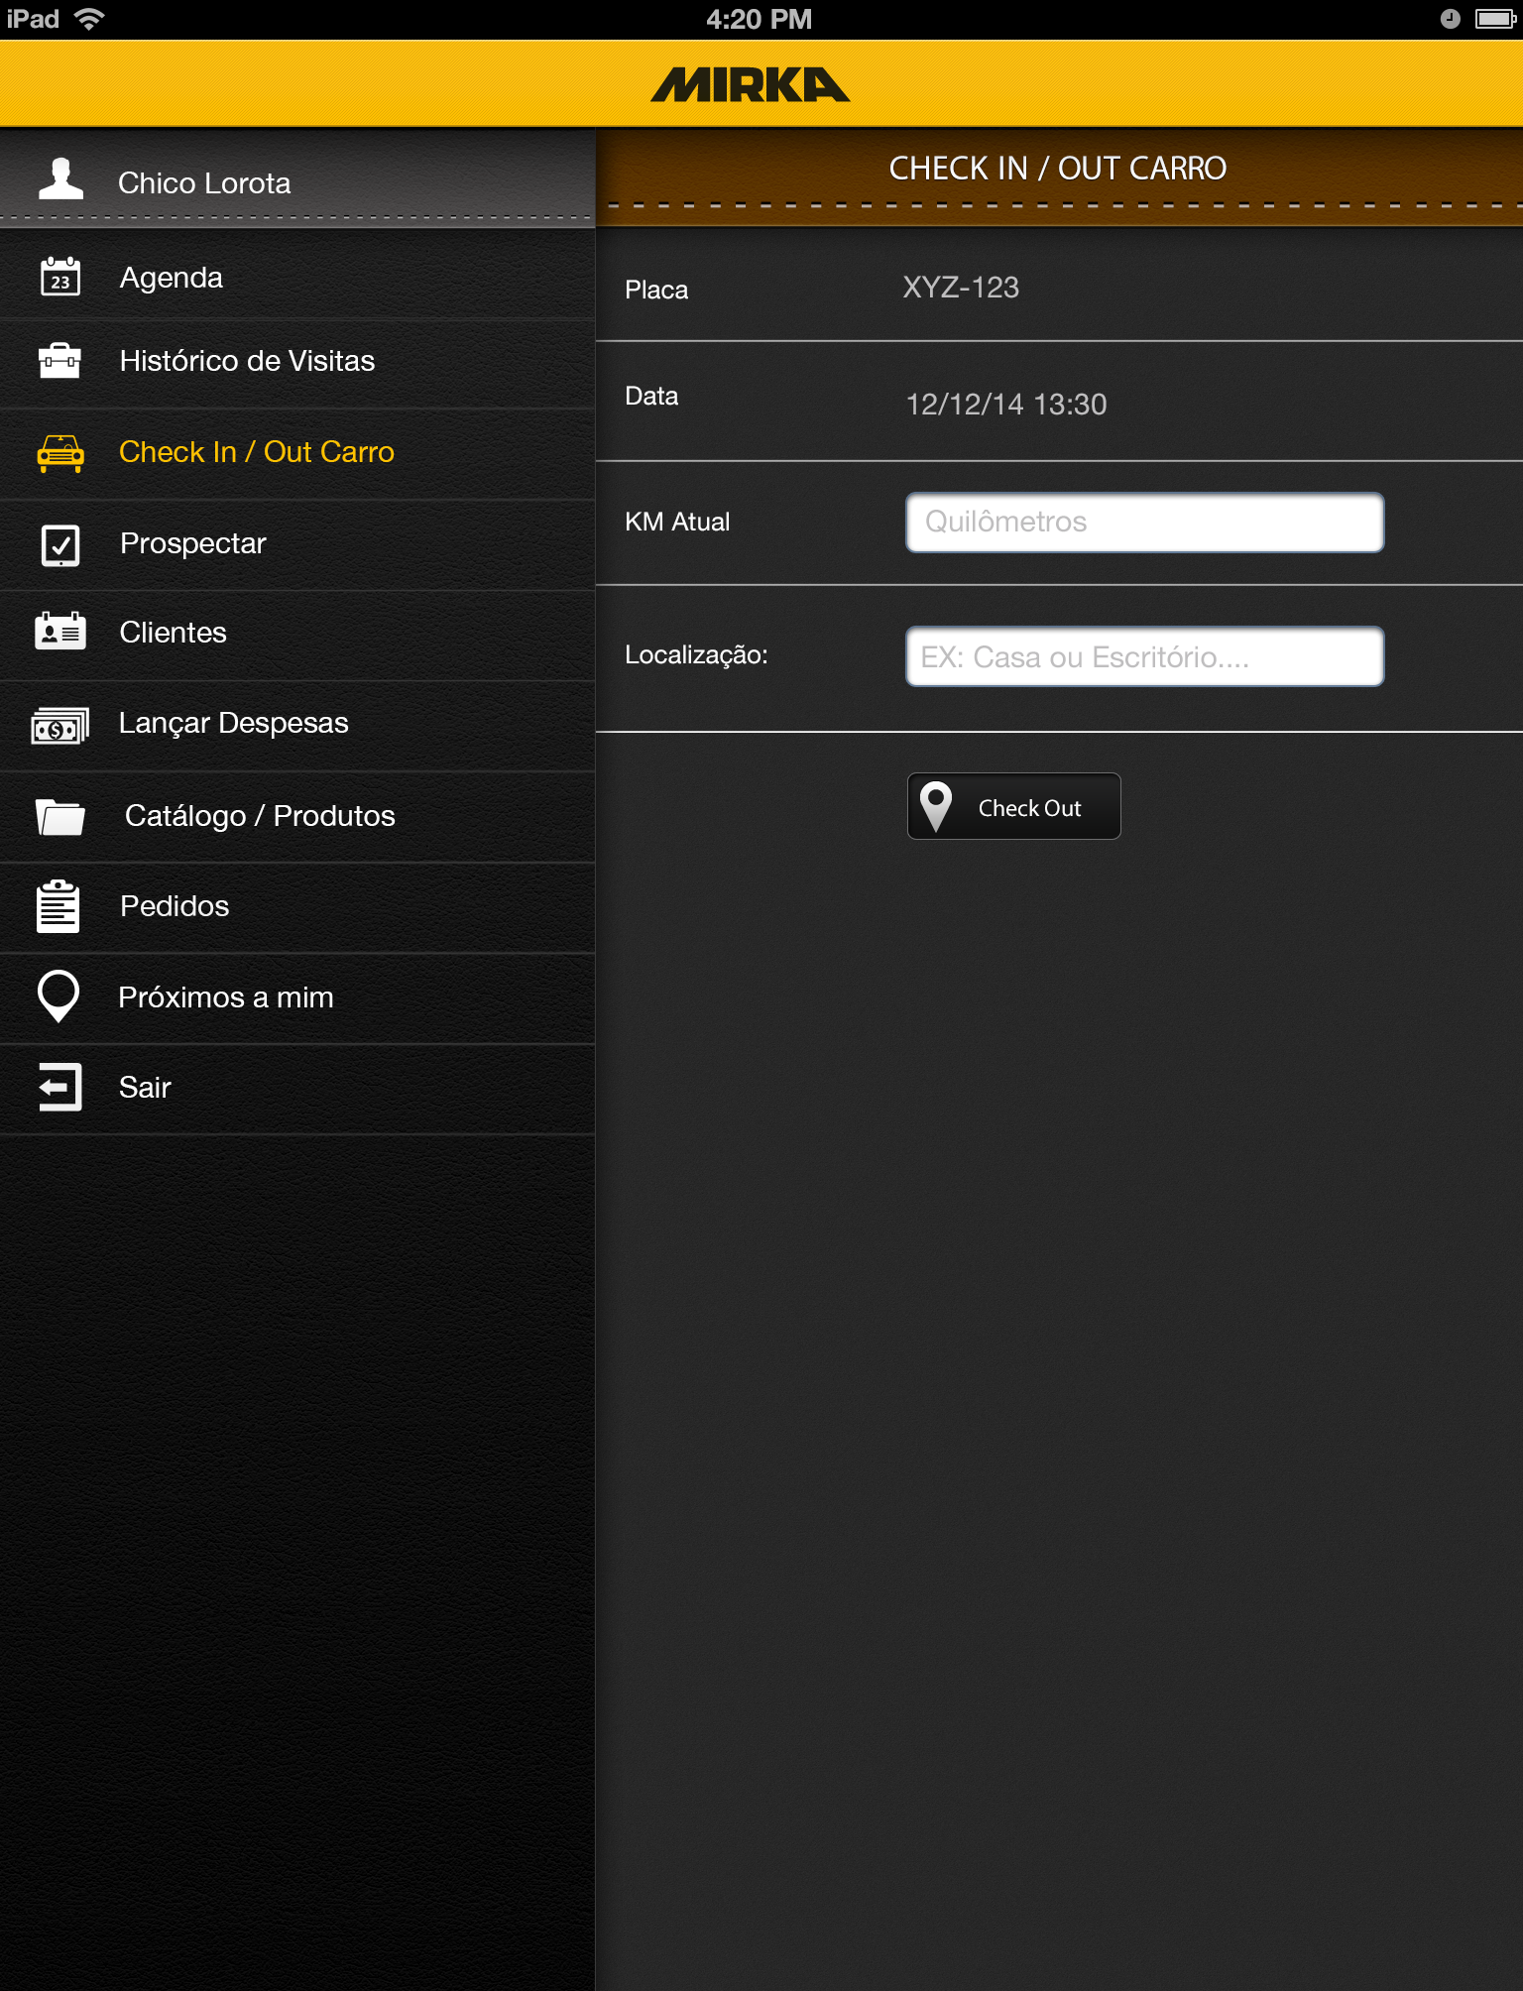
*Check in / out Carro “out” Tab
Pulls info from backend
Pulls info from backend
Open Text field
Open Text field
Takes you *Check in / out Carro “in”
Tab, Sends text field info to back end
PHASE 1

Slide 11
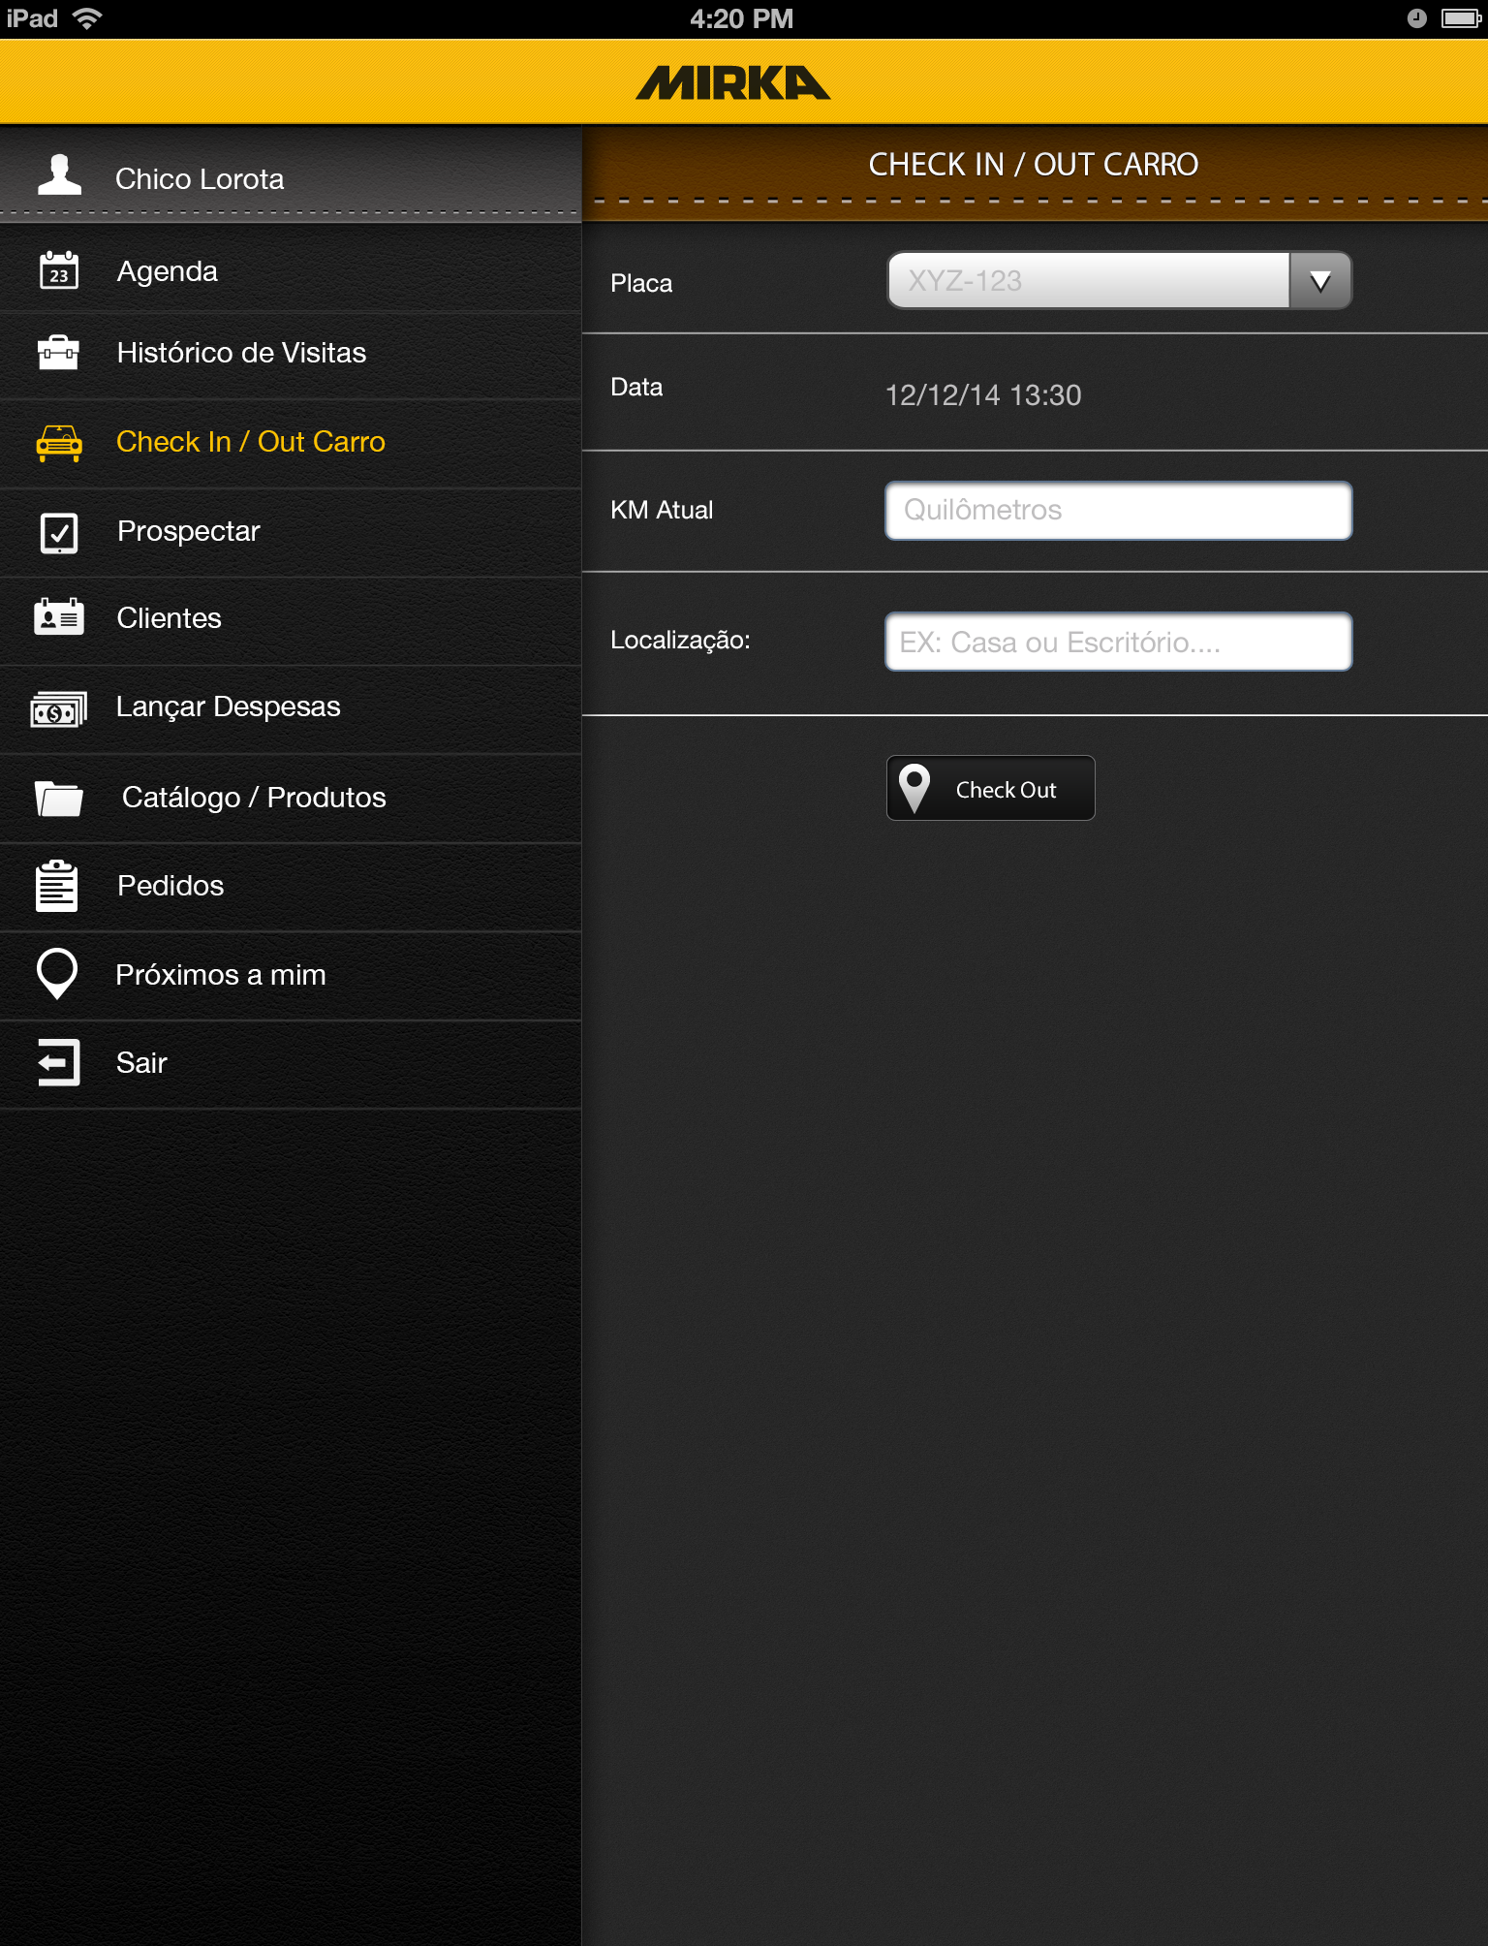
*Check in / out Carro Tab
Displays list from backend
Auto fills with last record of
KM but can still be edited but can not be changed to a lesser value than the last recorded

Slide 12
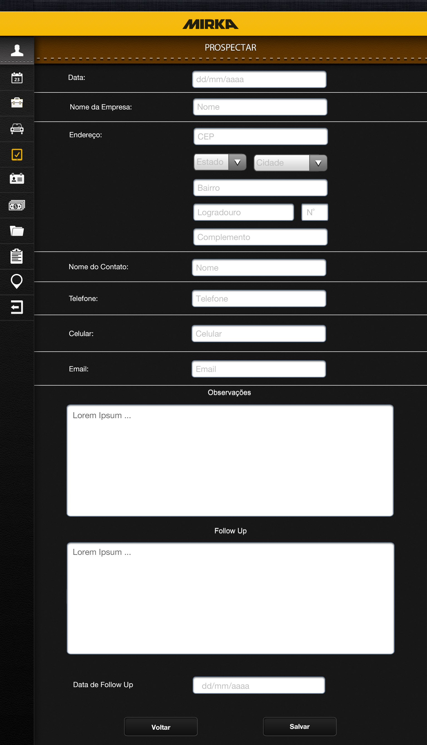
*Prospectar Tab
Text field limited to date format dd/mm/yyyy
Open Text field
Open Text field zip code format numbers only XXXXX-XXX
When zip code is enter address data is already filled if not
User selects state (brazil) and then is presented with city
Options in that state.
Open Text field
Text field limited to date format dd/mm/yyyy
Back, leave form filled
Sends form info to back and and clears it then opens
*clients options tab of new client that was created
PHASE 1

Slide 13
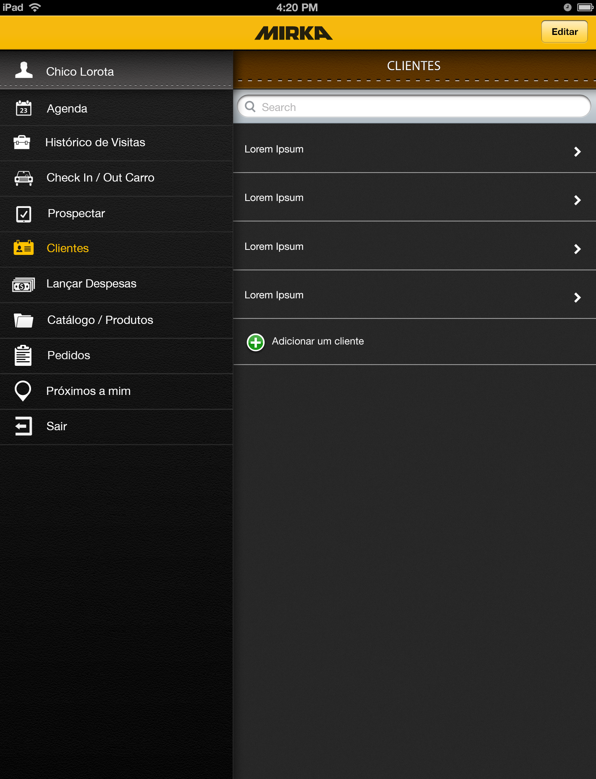
*Clientes Tab
Takes you to *clients editar tap
Search the client list
Takes you to *Clientes options tab
For that particular client
Takes you to *Prospectar tab

Slide 14
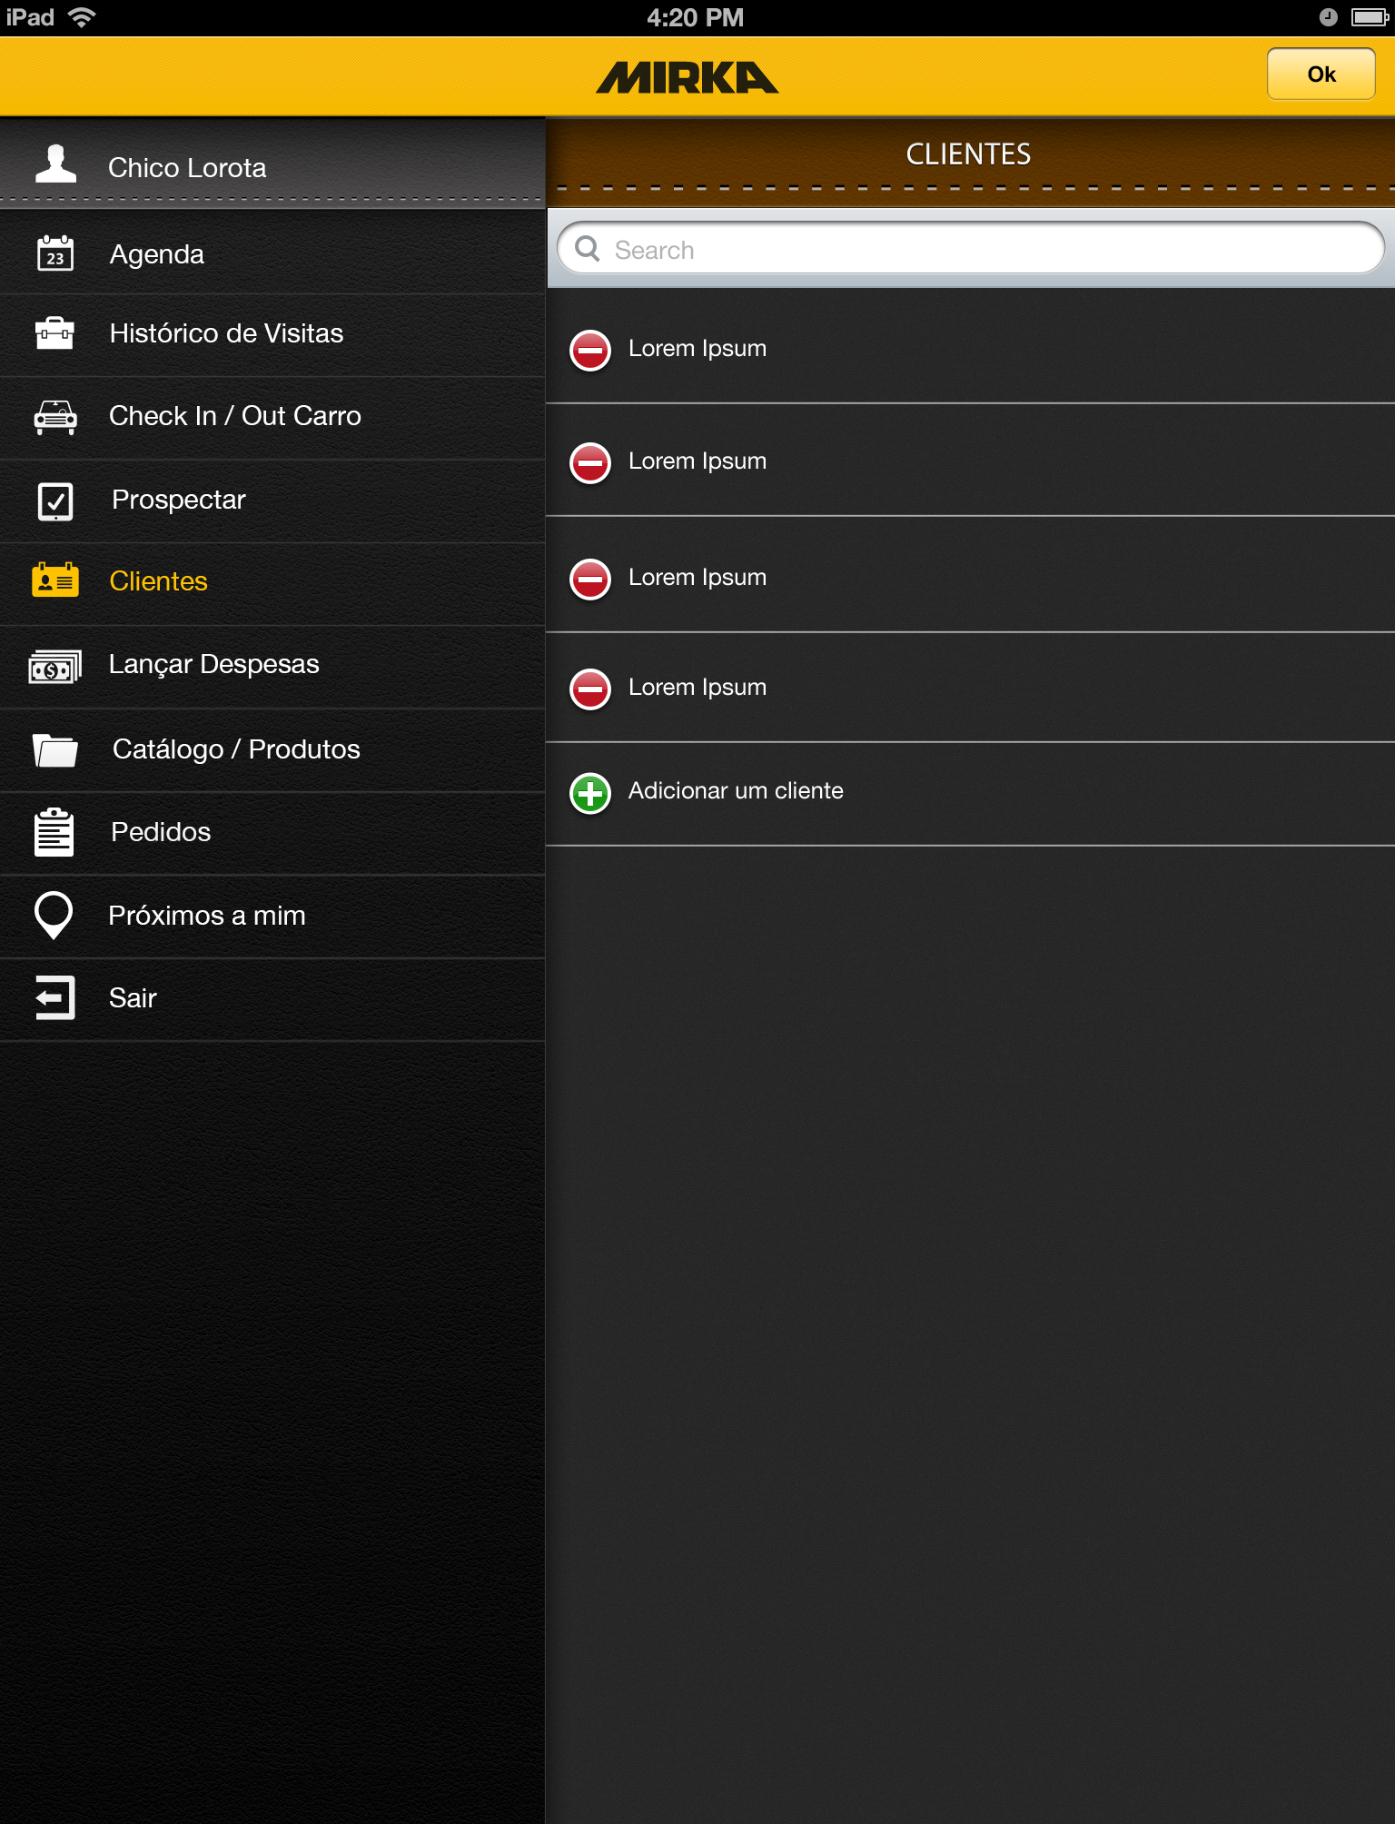
*Clientes editar Tab
Takes you to *clientes tab
Deletes client

Slide 15
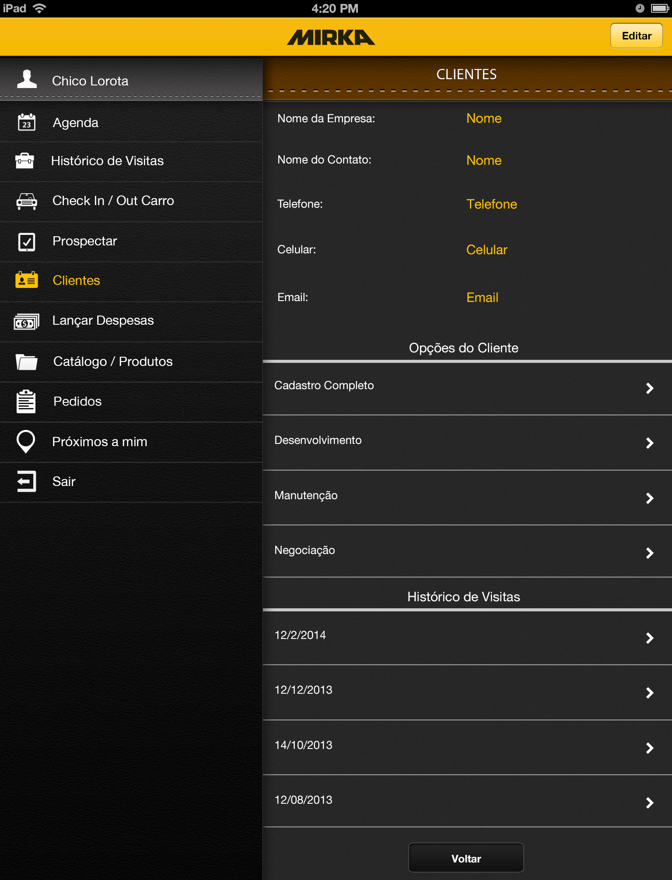
*Clientes options Tab
Pulls from back end
Displays basic client info
In read only form
Opens *Cadastro Clientes Tab
Opens *Desenvolvimento Tab
Opens *Manutenção Tab
Opens *Negociação Tab
When clicked takes you to *Detalhes de Visitas type tab (this Tab displays varies based on type of visit)

Slide 16
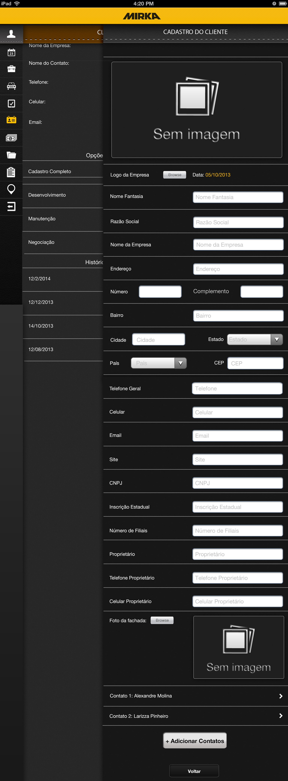
*Cadastro Clientes Tab
Date first registered pulls from prospectar
Accesses system camera control and camera roll
Open text fields
Auto filled from back end Prospectar info
Open text fields
Accesses system camera control and camera roll
Takes you to *contact info tab
Takes you to *contato do cliente tab

Slide 17
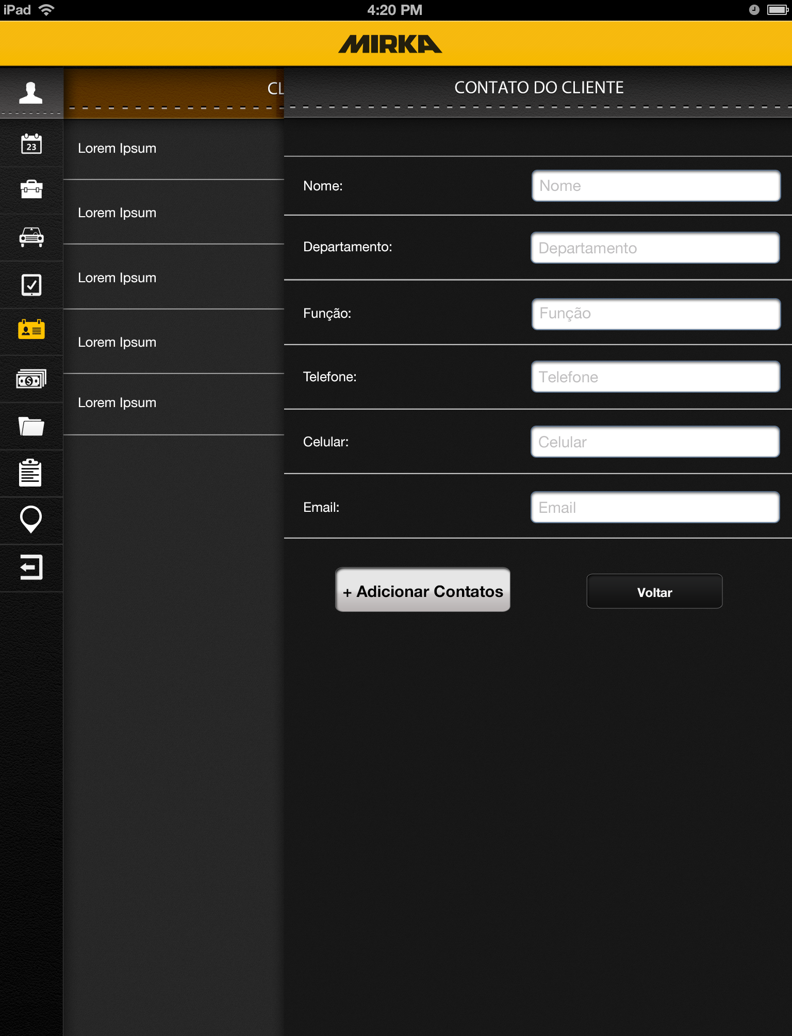
*Contato do Cliente Tab
Open text fields
When “+ Adicionar Cantatos” is clicked it adds contacts name to the list and clears the fields

Slide 18
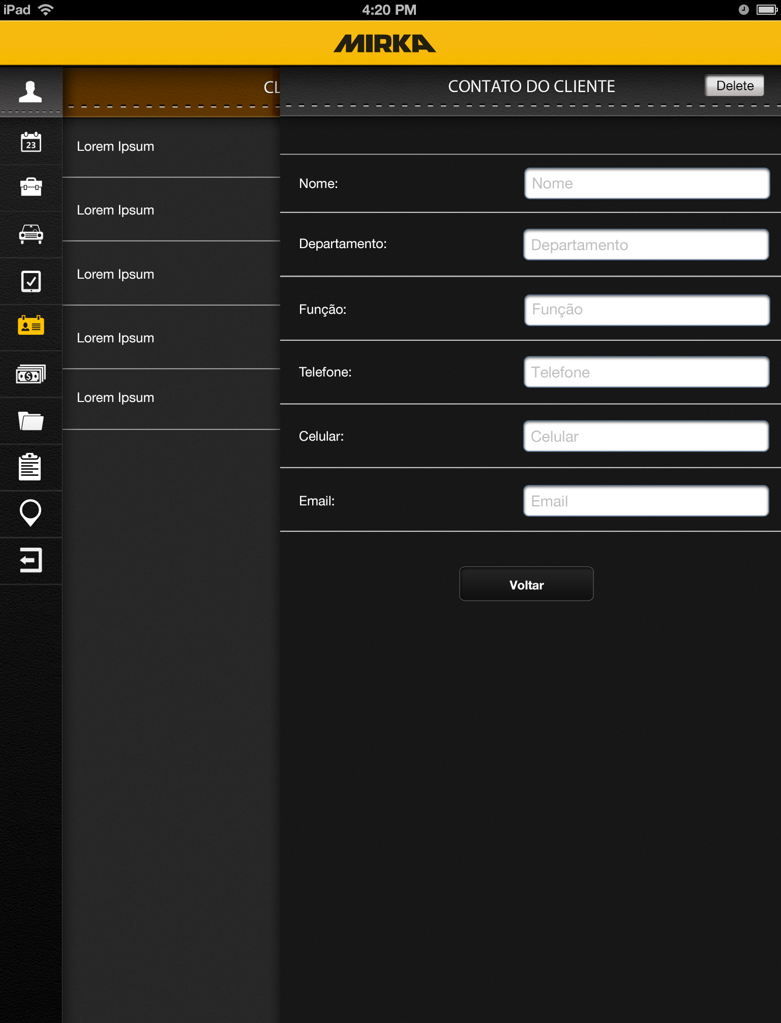
*Contato info Tab
Deletes client and returns to
*cadastro cliente tab
Open text fields auto filled
With contact info (editable)

Slide 19
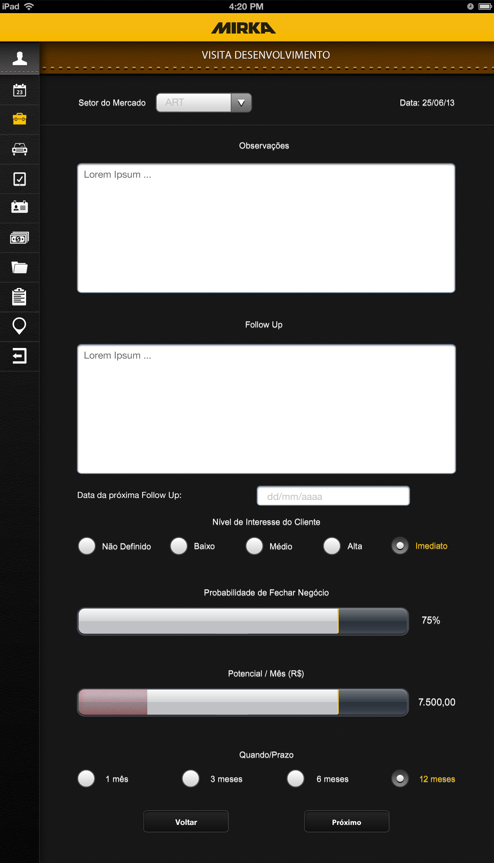
*Desenvolvimento Tab
Drop down info pulled from back end sets flow for next pages
Open text fields
Date field
Radio buttons
Slider bar scale 0-100, starts dark grey
When empty and changes/fills to light grey
As user slides finger across bar from right to left
Slider bar scale 0-10,000, starts dark grey
When empty, turns red until 2,500 until and changes/fills to light grey as user slides finger across bar from right to left
Radio buttons
Takes you to *Desenvolvimento setor do mercado type tab.

Slide 20
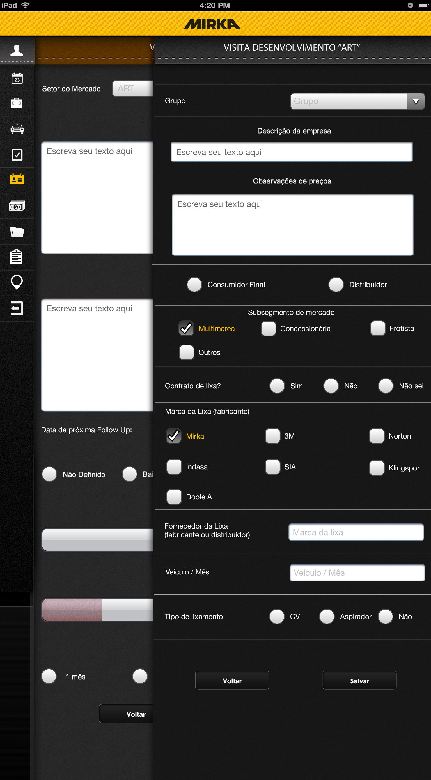
*Desenvolvimento ART Tab
Dropdown from back end
Open text
Radio button
Check box
Radio button
Open text field
Radio button
Takes you to *Lista dos produtos ART Tab

Slide 21
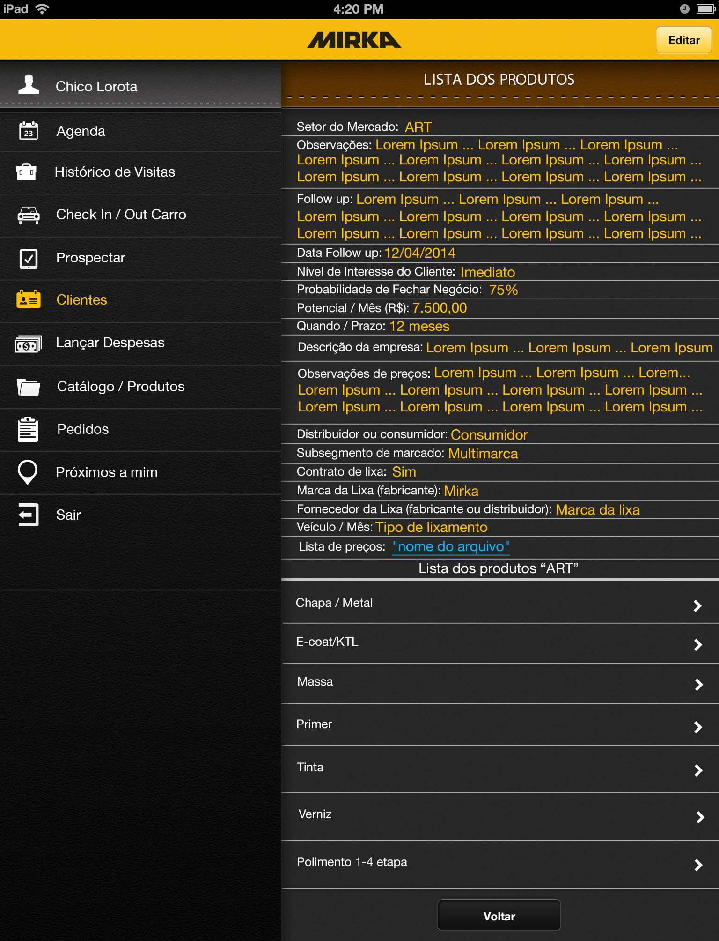
*Lista dos produtos ART Tab
Takes you back to the *Desenvolvimento ART Tab with fields filled in
List info from Desenvolvimento
Fields in read only form
Link to PDF file uploaded on
Back end
Goes to *Lista Chapa metal Tab
Goes to *Lista E-coat/KTL Tab
Goes to *Lista Massa Tab
Goes to *Lista Primer Tab
Goes to *Lista Tinta Tab
Goes to *Lista Verniz Tab
Goes to *Lista Polimento Tab

Slide 22

*Desenvolvimento OEM Tab
Dropdown from back end
Open text
Radio button
Check box
Radio button
Open text field
Radio button
Takes you to *Lista dos produtos OEM Tab

Slide 23
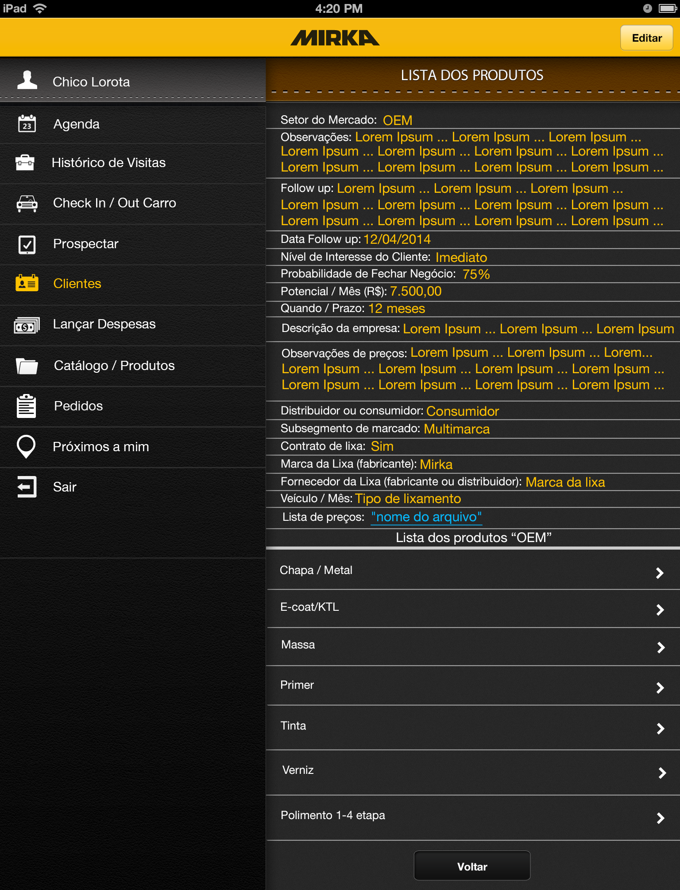
*Lista dos produtos OEM Tab
Takes you back to the *Desenvolvimento OEM Tab with fields filled in
List info from Desenvolvimento
Fields in read only form
Link to PDF file uploaded on
Back end
Goes to *Lista Chapa metal Tab
Goes to *Lista E-coat/KTL Tab
Goes to *Lista Massa Tab
Goes to *Lista Primer Tab
Goes to *Lista Tinta Tab
Goes to *Lista Verniz Tab
Goes to *Lista Polimento Tab

Slide 24
*Desenvolvimento OEM TIER 1 Tab
Dropdown from back end
Open text
Radio button
Check box
Radio button
Open text field
Radio button
Takes you to *Lista dos produtos OEM TIER 1 Tab

Slide 25

*Lista dos produtos OEM TIER 1 Tab
Takes you back to the *Desenvolvimento OEM-TIER1 Tab with fields filled in
List info from Desenvolvimento
Fields in read only form
Link to PDF file uploaded on
Back end
Goes to *Lista Chapa metal Tab
Goes to *Lista E-coat/KTL Tab
Goes to *Lista Massa Tab
Goes to *Lista Primer Tab
Goes to *Lista Tinta Tab
Goes to *Lista Verniz Tab
Goes to *Lista Polimento Tab

Slide 26
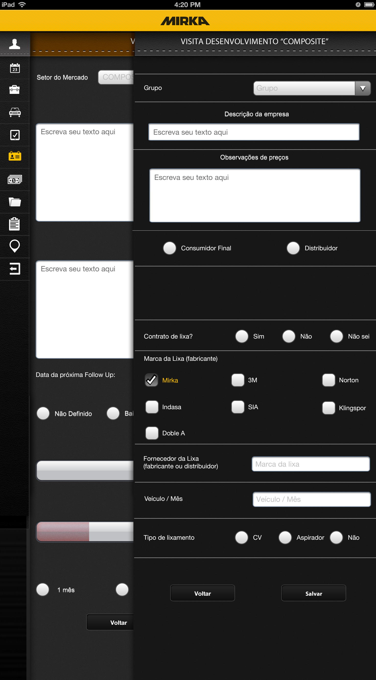
*Desenvolvimento COMPOSITE Tab
Dropdown from back end
Open text
Radio button
Check box (DOESN’T SHOW)
Radio button
Open text field
Radio button
Takes you to *Lista dos produtos COMPOSITE Tab

Slide 27
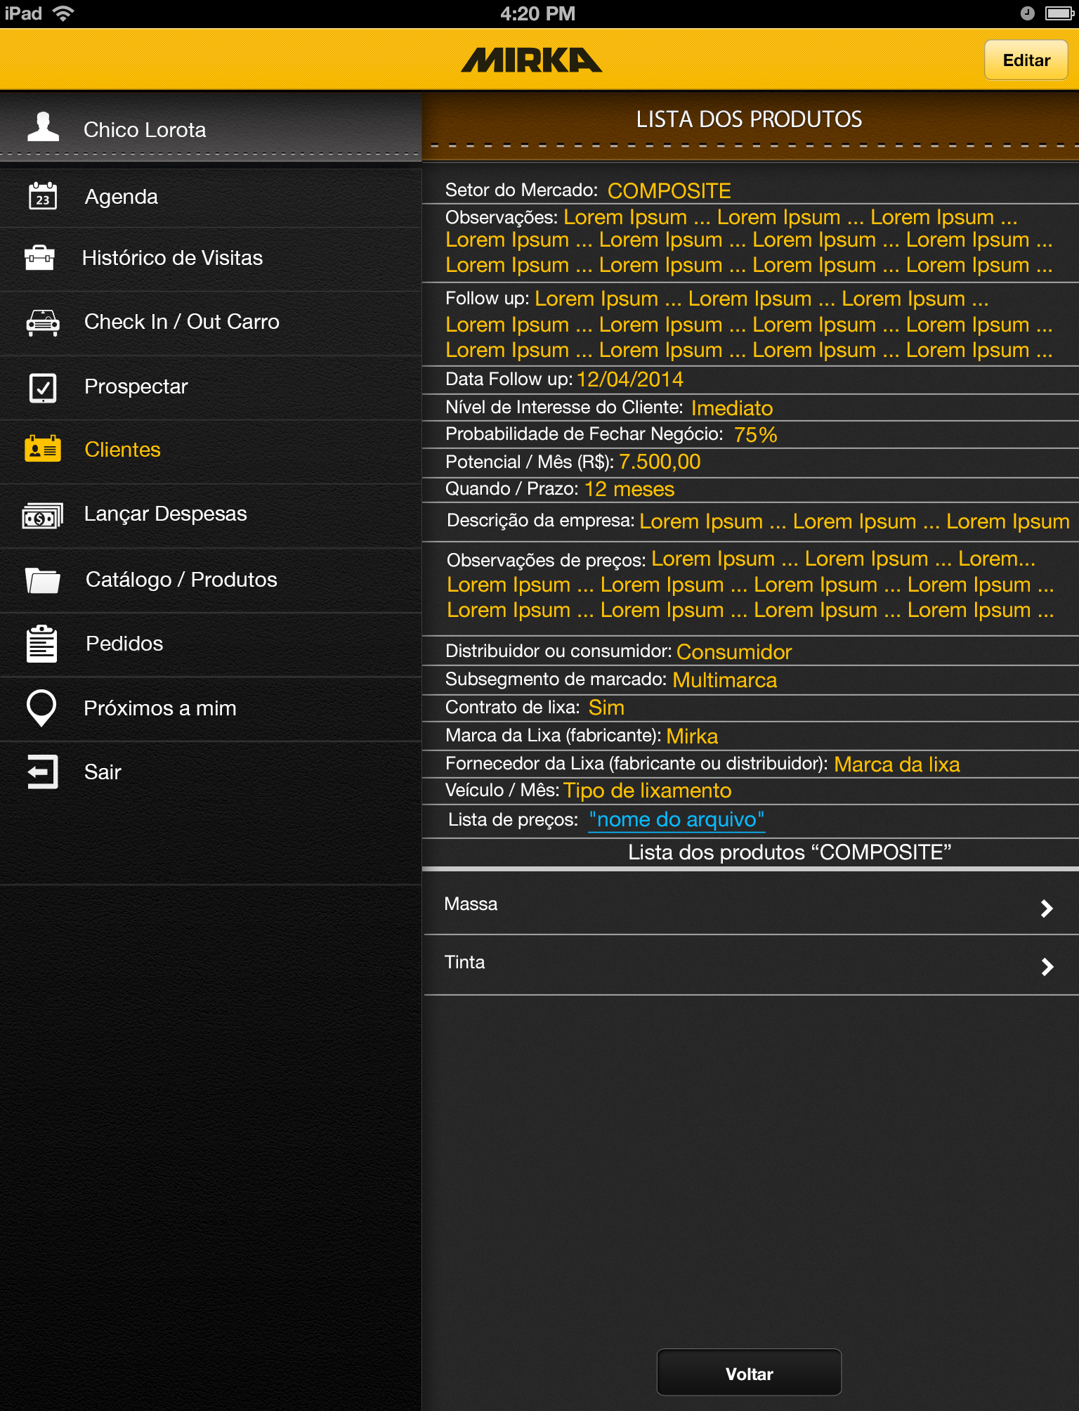
*Lista dos produtos COMPOSITE Tab
Takes you back to the *Desenvolvimento COMPOSITE Tab with fields filled in
List info from Desenvolvimento
Fields in read only form
Link to PDF file uploaded on
Back end
Goes to *Lista Massa Tab
Goes to *Lista Tinta Tab

Slide 28
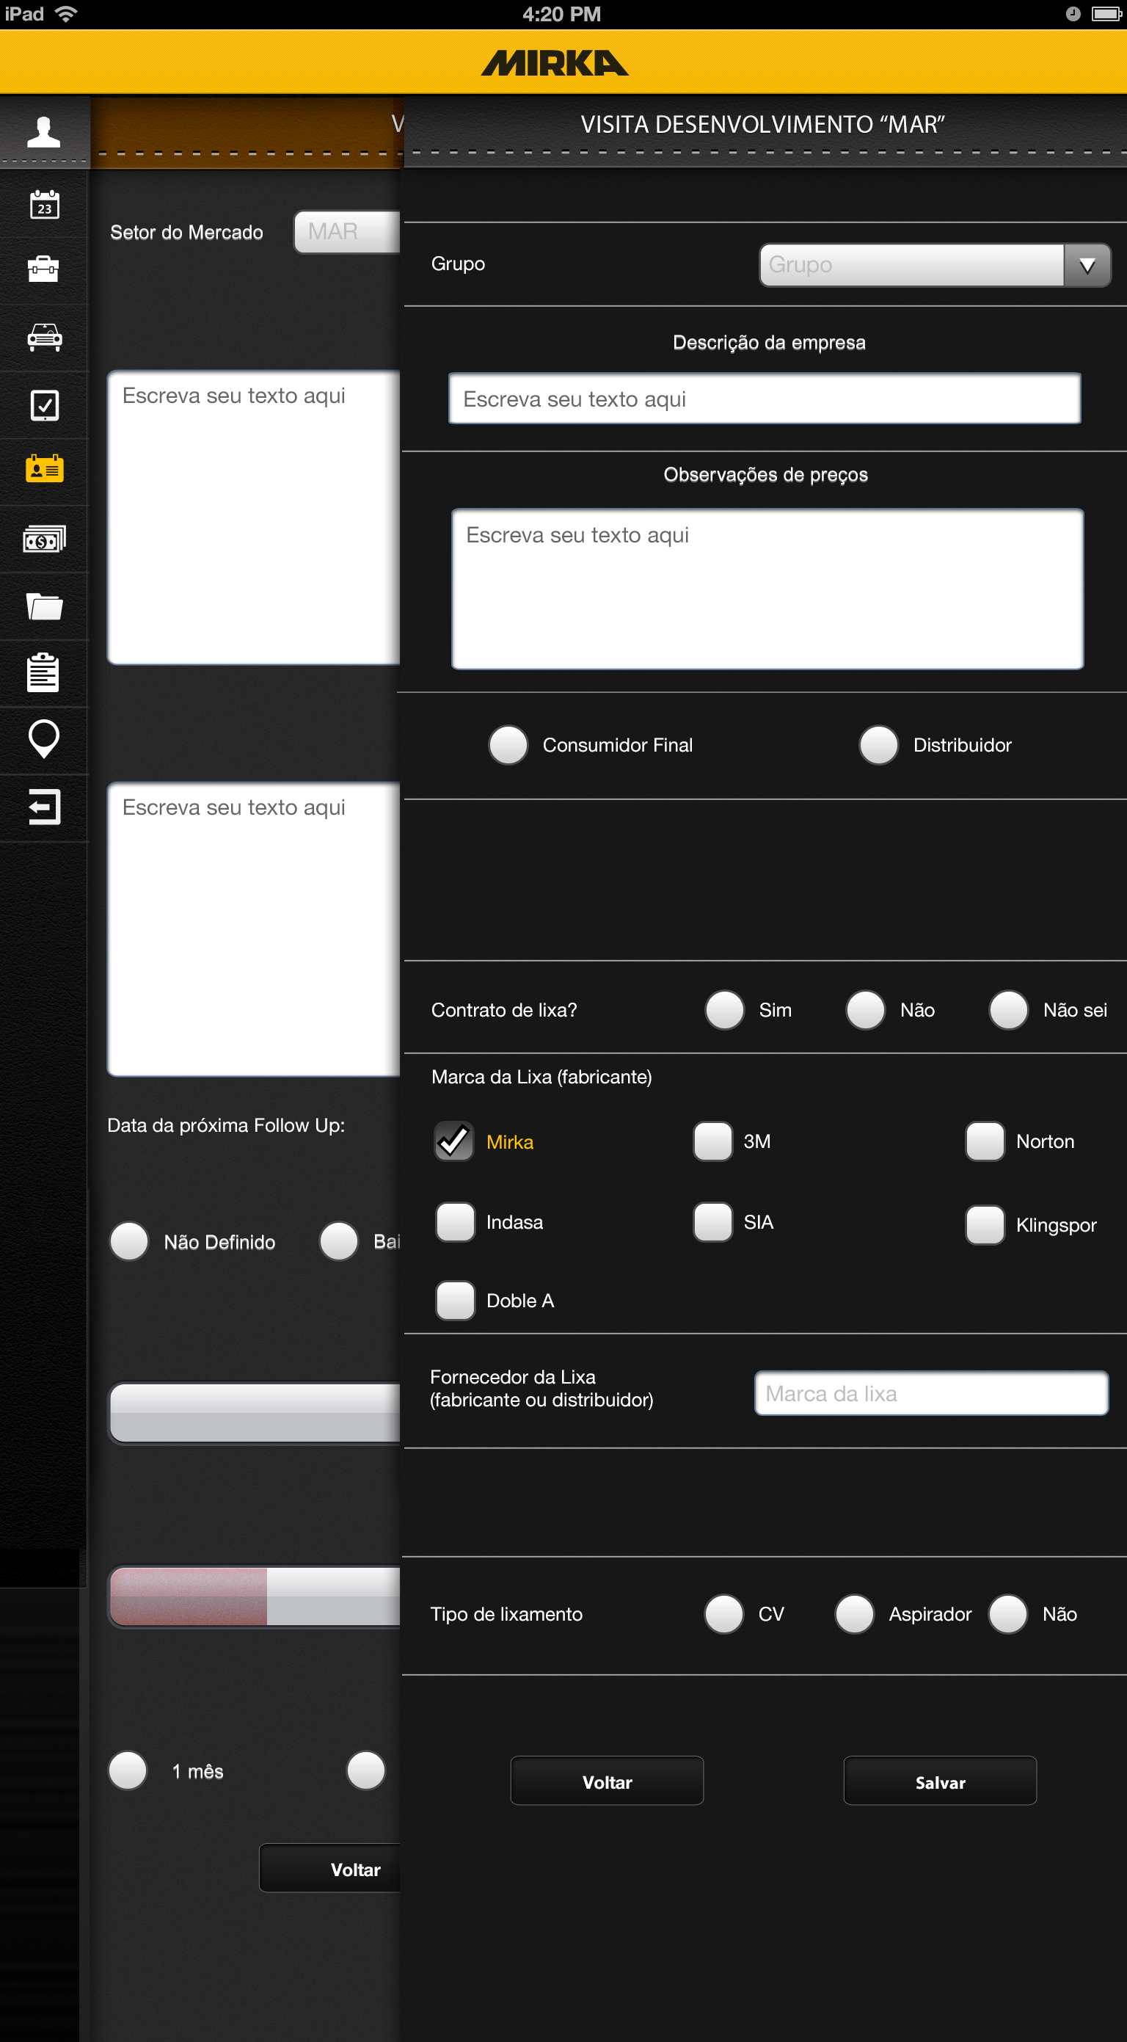
*Desenvolvimento MAR Tab
Dropdown from back end
Open text
Radio button
Check box (DOESN’T SHOW)
Radio button
Open text field
Radio button
Takes you to *Lista dos produtos MAR Tab

Slide 29

*Lista dos produtos MAR Tab
Takes you back to the *Desenvolvimento MAR Tab with fields filled in
List info from Desenvolvimento
Fields in read only form
Link to PDF file uploaded on
Back end
Goes to *Lista Massa Tab
Goes to *Lista Tinta Tab
Goes to *Lista Polimento Tab

Slide 30
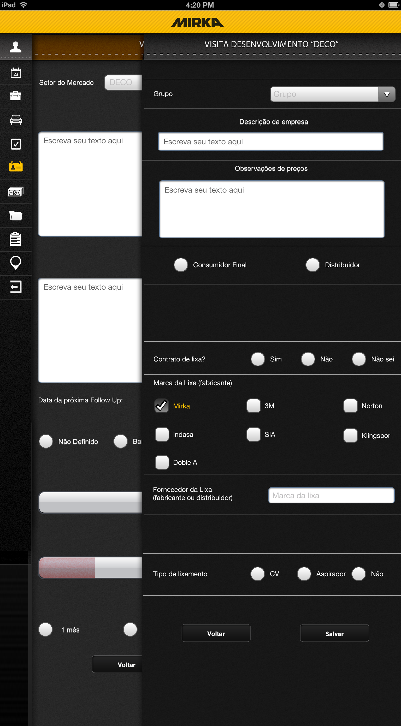
*Desenvolvimento DECO Tab
Dropdown from back end
Open text
Radio button
Check box (DOESN’T SHOW)
Radio button
Open text field
Radio button
Takes you to *Lista dos produtos DECO Tab

Slide 31

*Lista dos produtos DECO Tab
Takes you back to the *Desenvolvimento DECO Tab with fields filled in
List info from Desenvolvimento
Fields in read only form
Link to PDF file uploaded on
Back end
Goes to *Lista Massa Tab
Goes to *Lista Tinta Tab

Slide 32
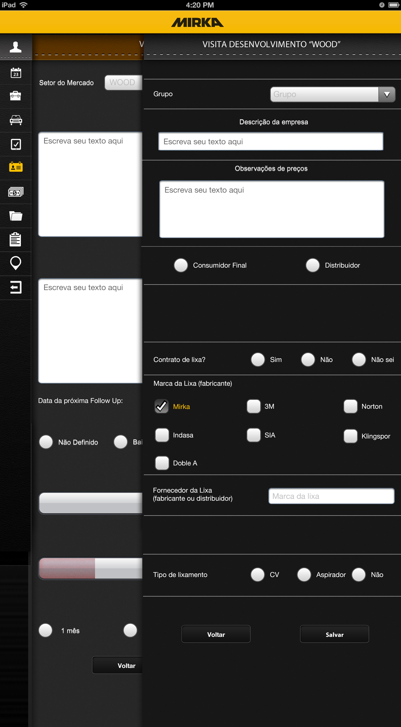
*Desenvolvimento WOOD Tab
Dropdown from back end
Open text
Radio button
Check box (DOESN’T SHOW)
Radio button
Open text field
Radio button
Takes you to *Lista dos produtos WOOD Tab

Slide 33
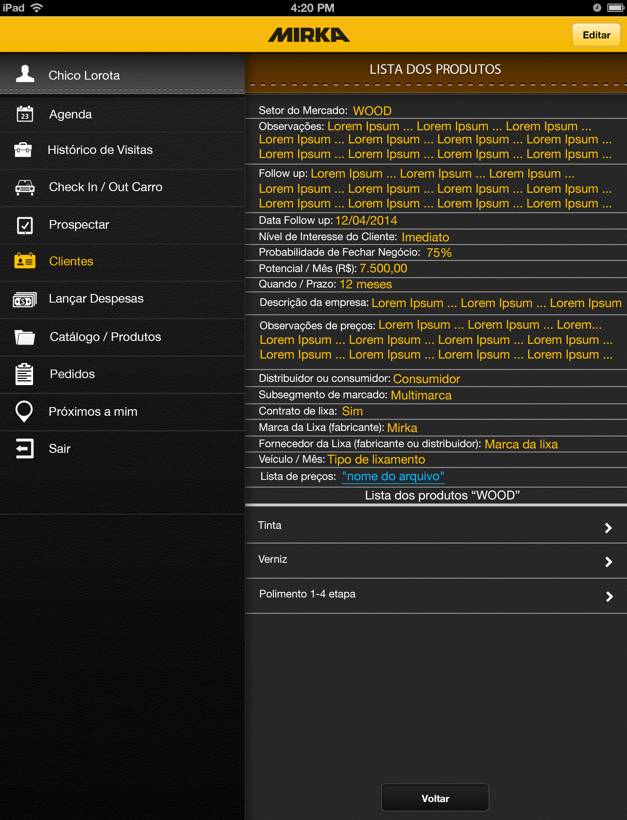
*Lista dos produtos WOOD Tab
Takes you back to the *Desenvolvimento WOOD Tab with fields filled in
List info from Desenvolvimento
Fields in read only form
Link to PDF file uploaded on
Back end
Goes to *Lista Tinta Tab
Goes to *Lista Verniz Tab
Goes to *Lista Polimento Tab

Slide 34
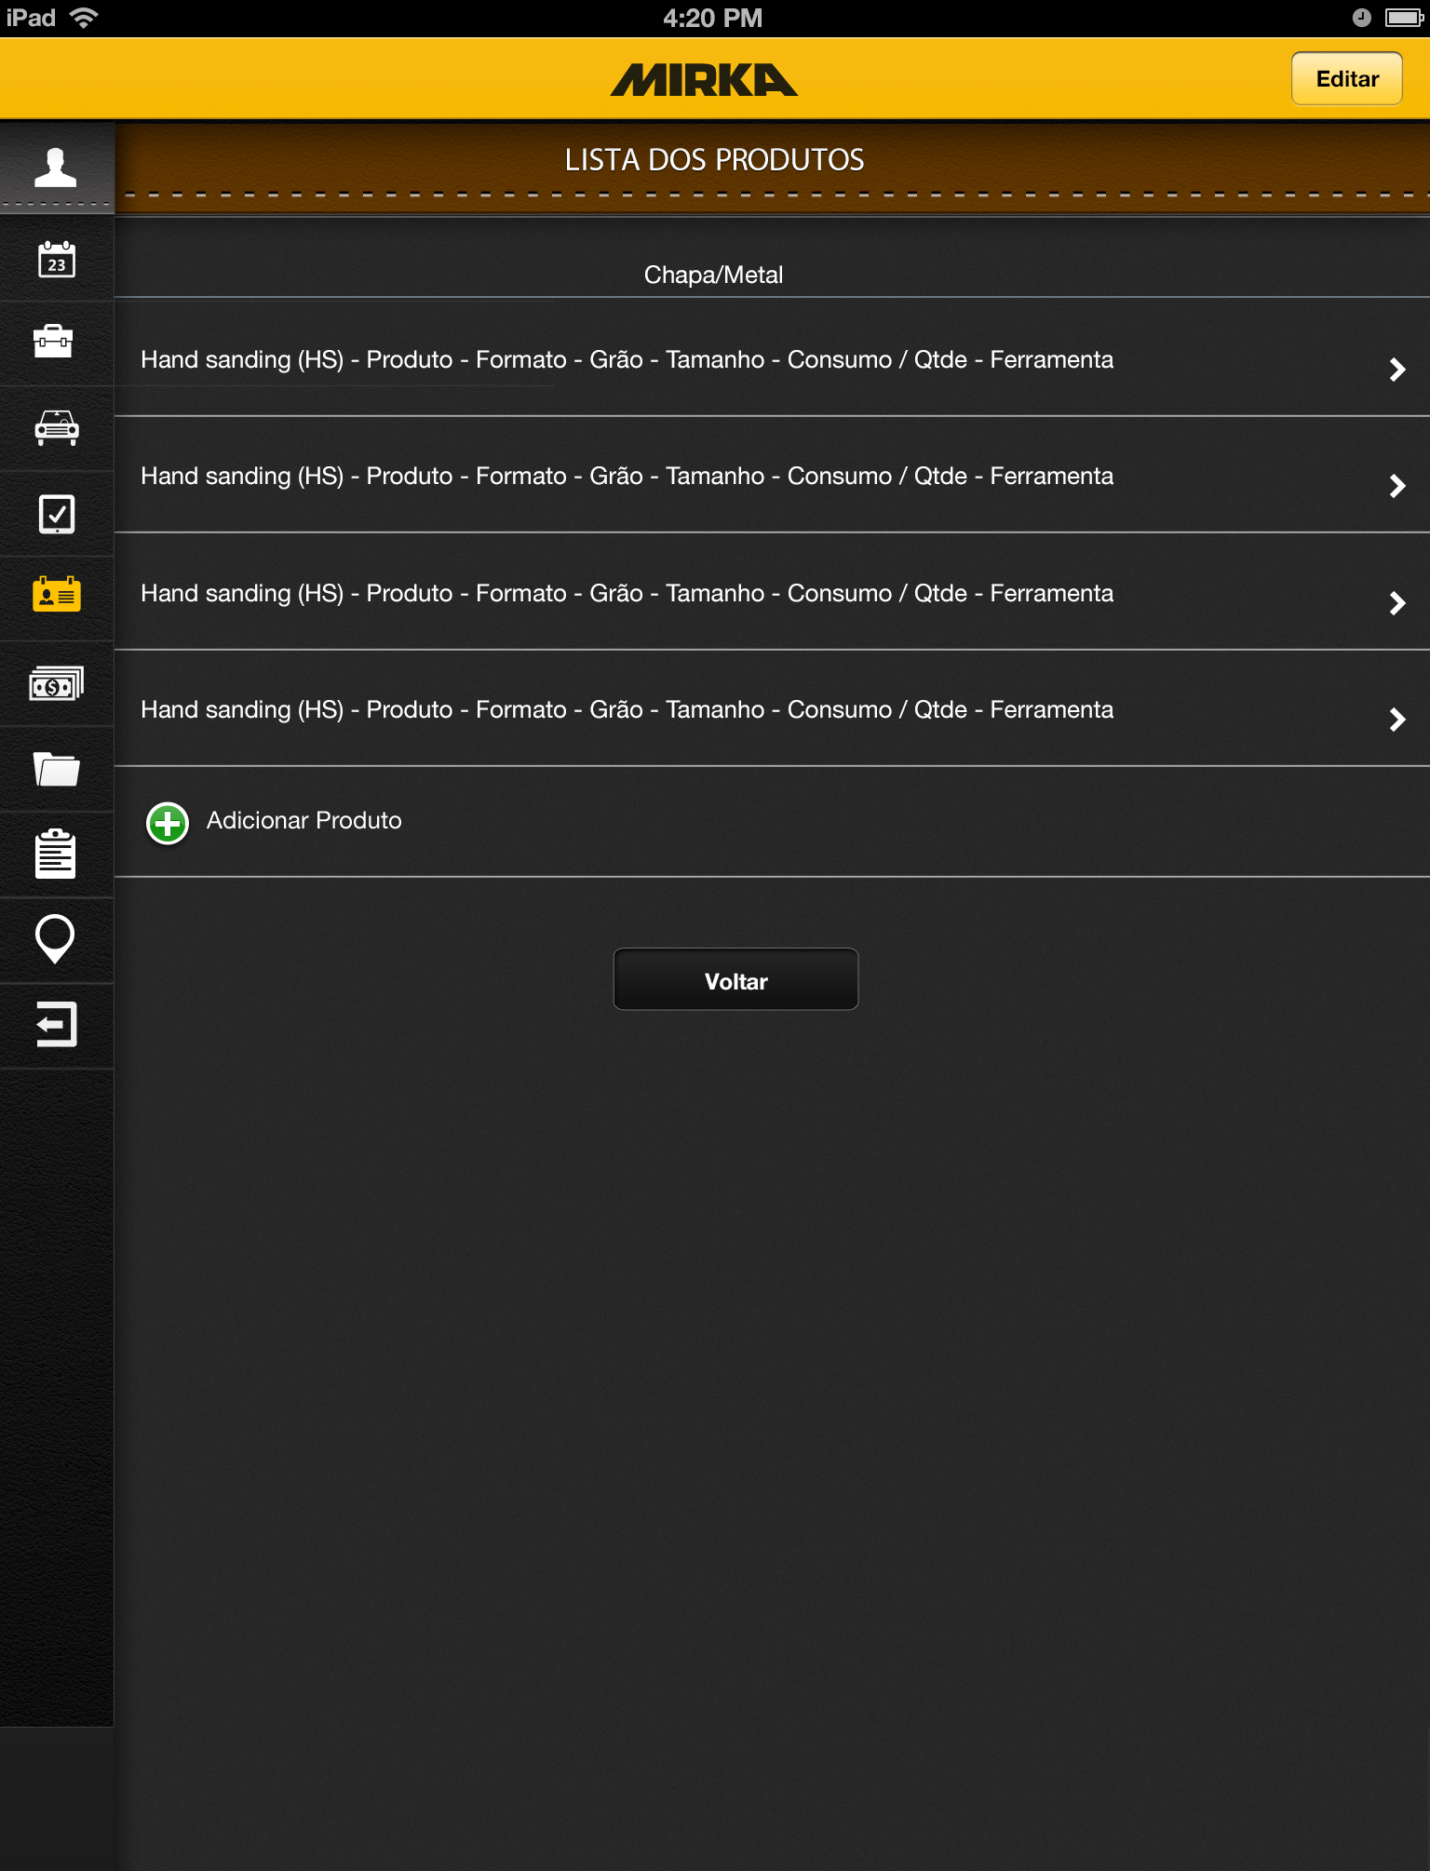
*Lista Chapa metal Tab
Takes you to *Lista Chapa metal Editar Tab
Takes you to *Chapa metal Tab with data
Autofilled with data from product
Takes you to *Chapa metal Tab

Slide 35
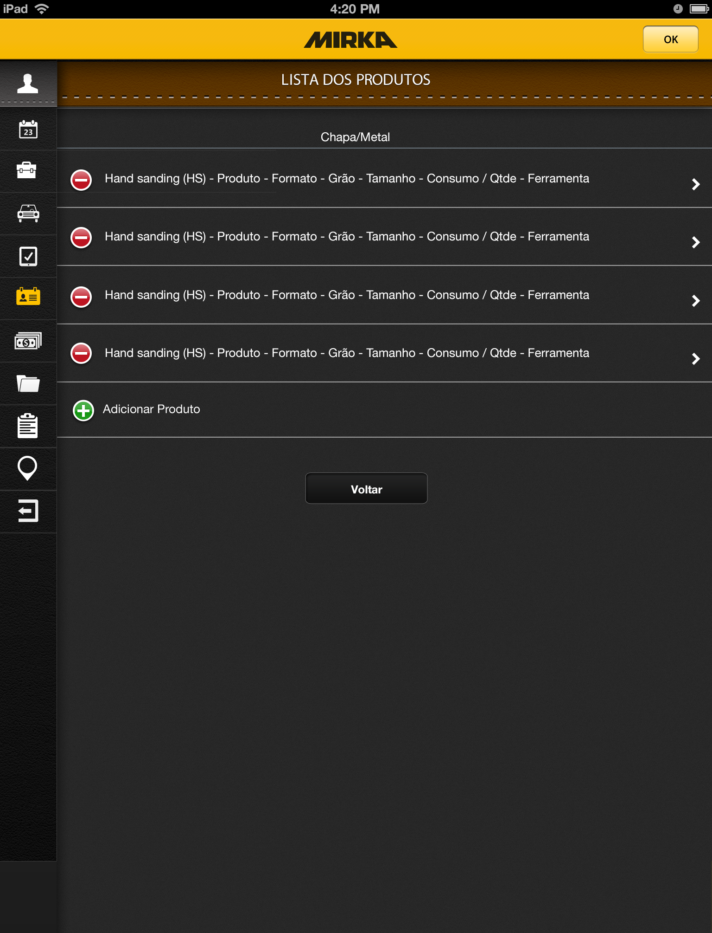
*Lista Chapa metal editar Tab
Takes you to *Lista Chapa metal Tab
Deletes product
Takes you to *Chapa metal Tab

Slide 36
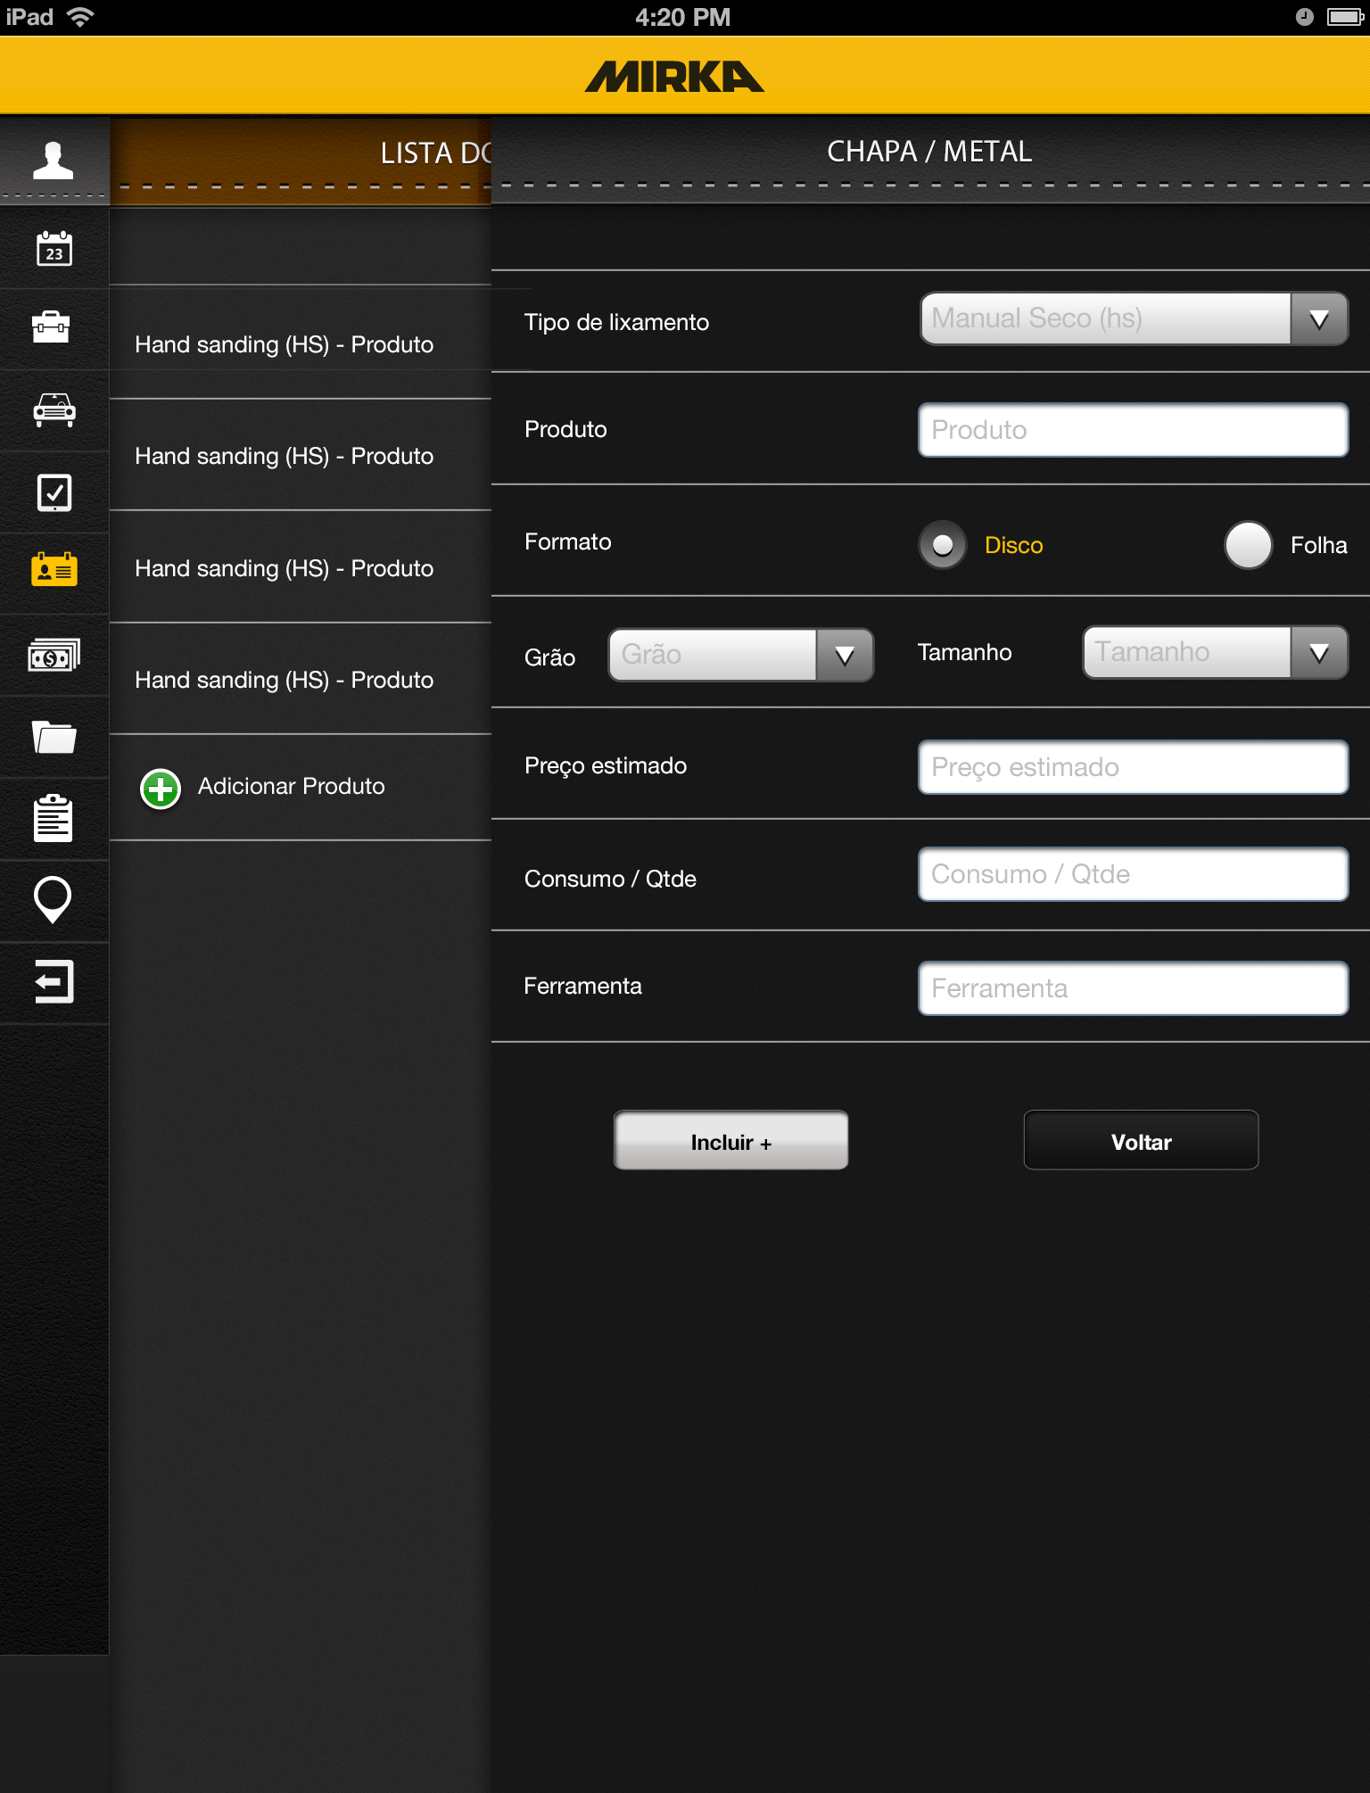
*Chapa metal Tab
Drop down from backend
Open text field
Radio button
Drop down from backend
Open text fields
Adds product to list and
Clears fields

Slide 37
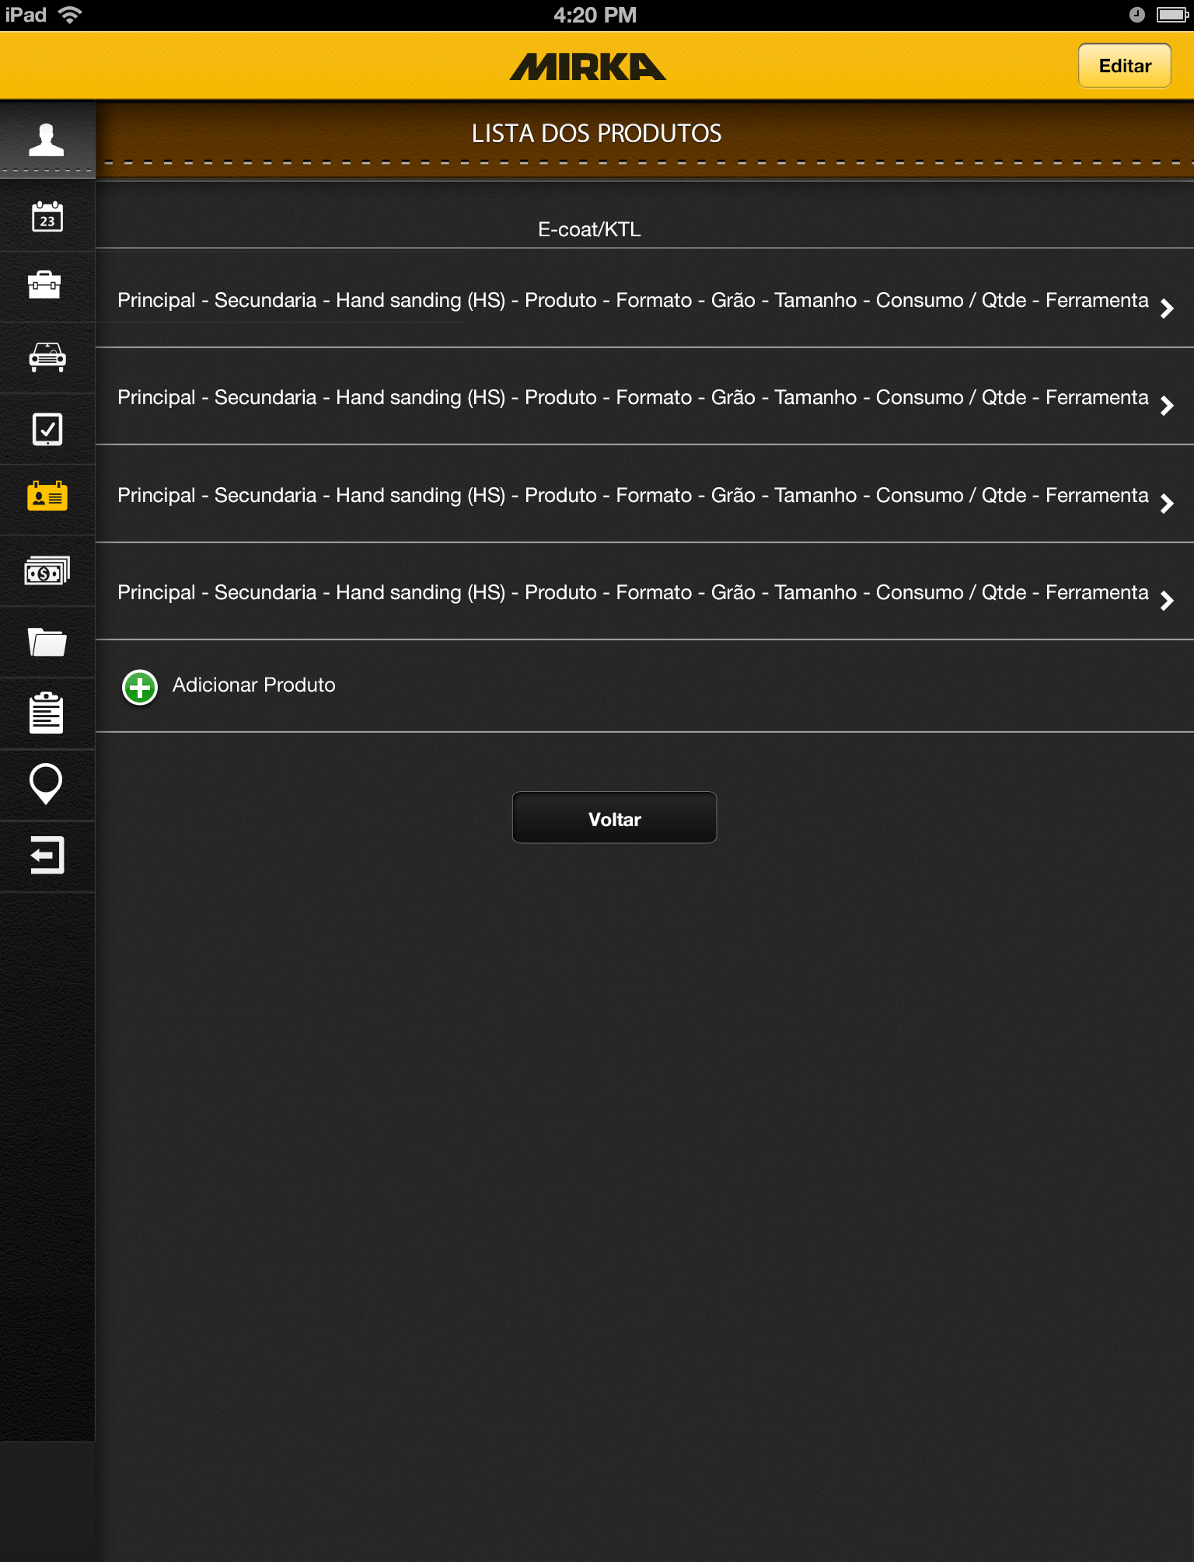
*Lista E-coat/KTL Tab
Takes you to *Lista E-coat/KTL Editar Tab
Takes you to *E-coat/KTL Tab with data
Autofilled with data from product
Takes you to *E-coat/KTL Tab

Slide 38
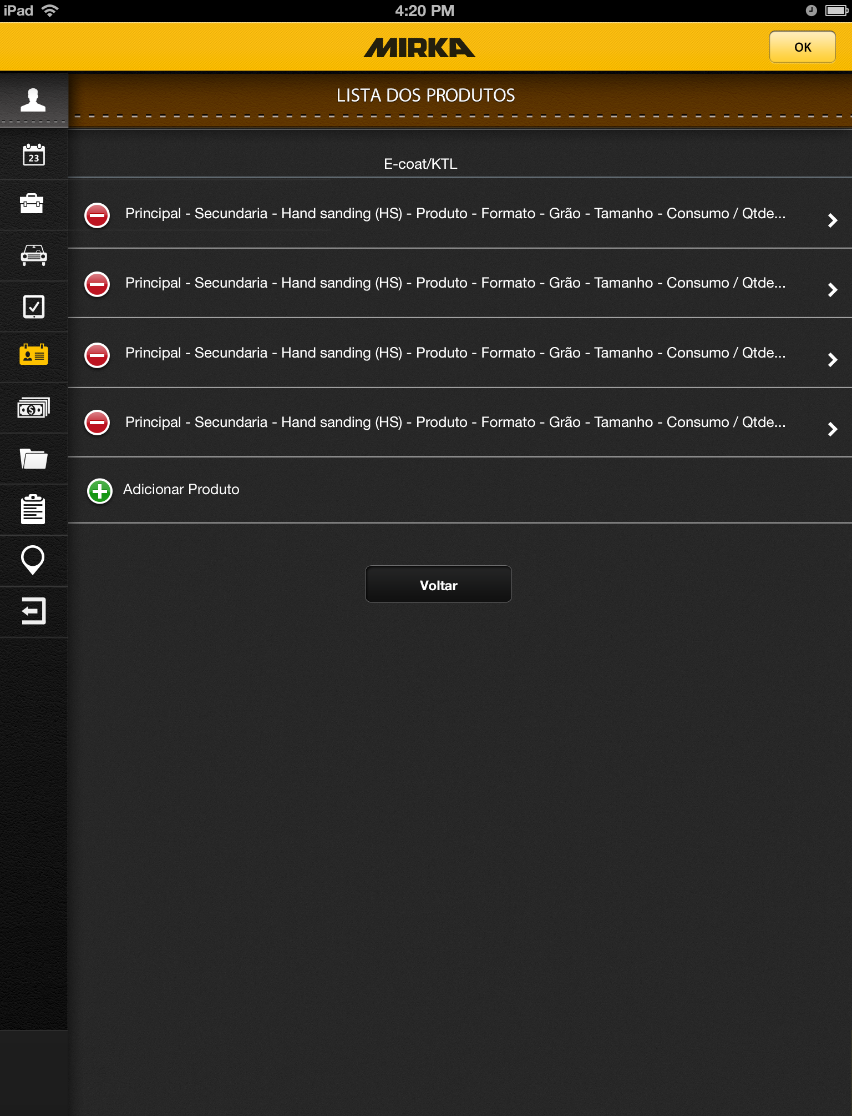
*Lista E-coat/KTL Editar Tab
Takes you to *Lista E-coat/KTL Tab
Deletes product
Takes you to *E-coat/KTL Tab

Slide 39
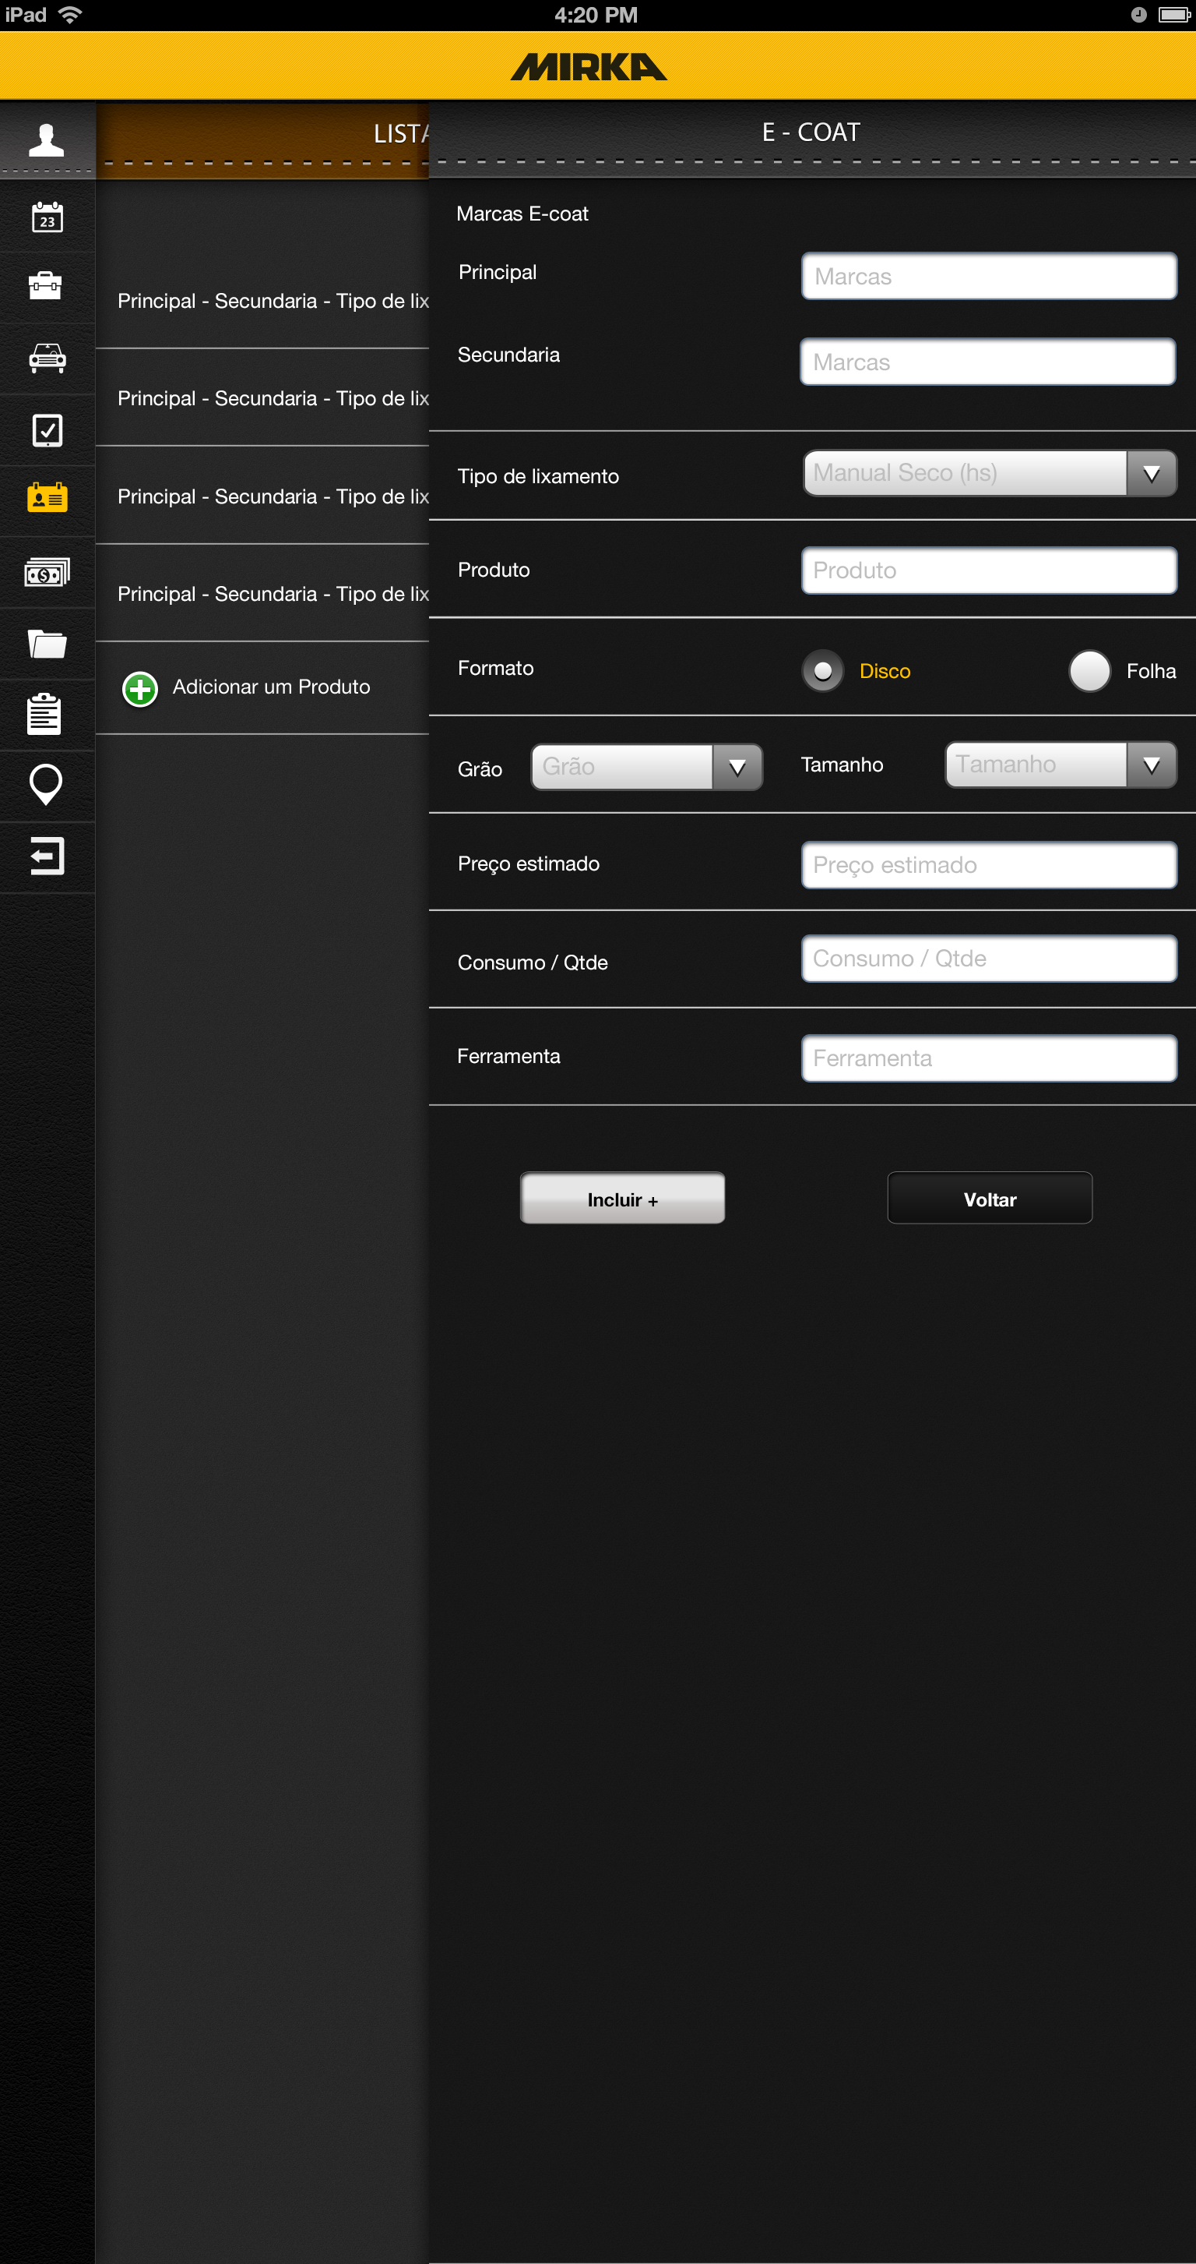
*E-coat/KTL Tab
Open text fields
Drop down from backend
Open text field
Radio button
Drop down from backend
Open text fields
Adds product to list and
Clears fields

Slide 40
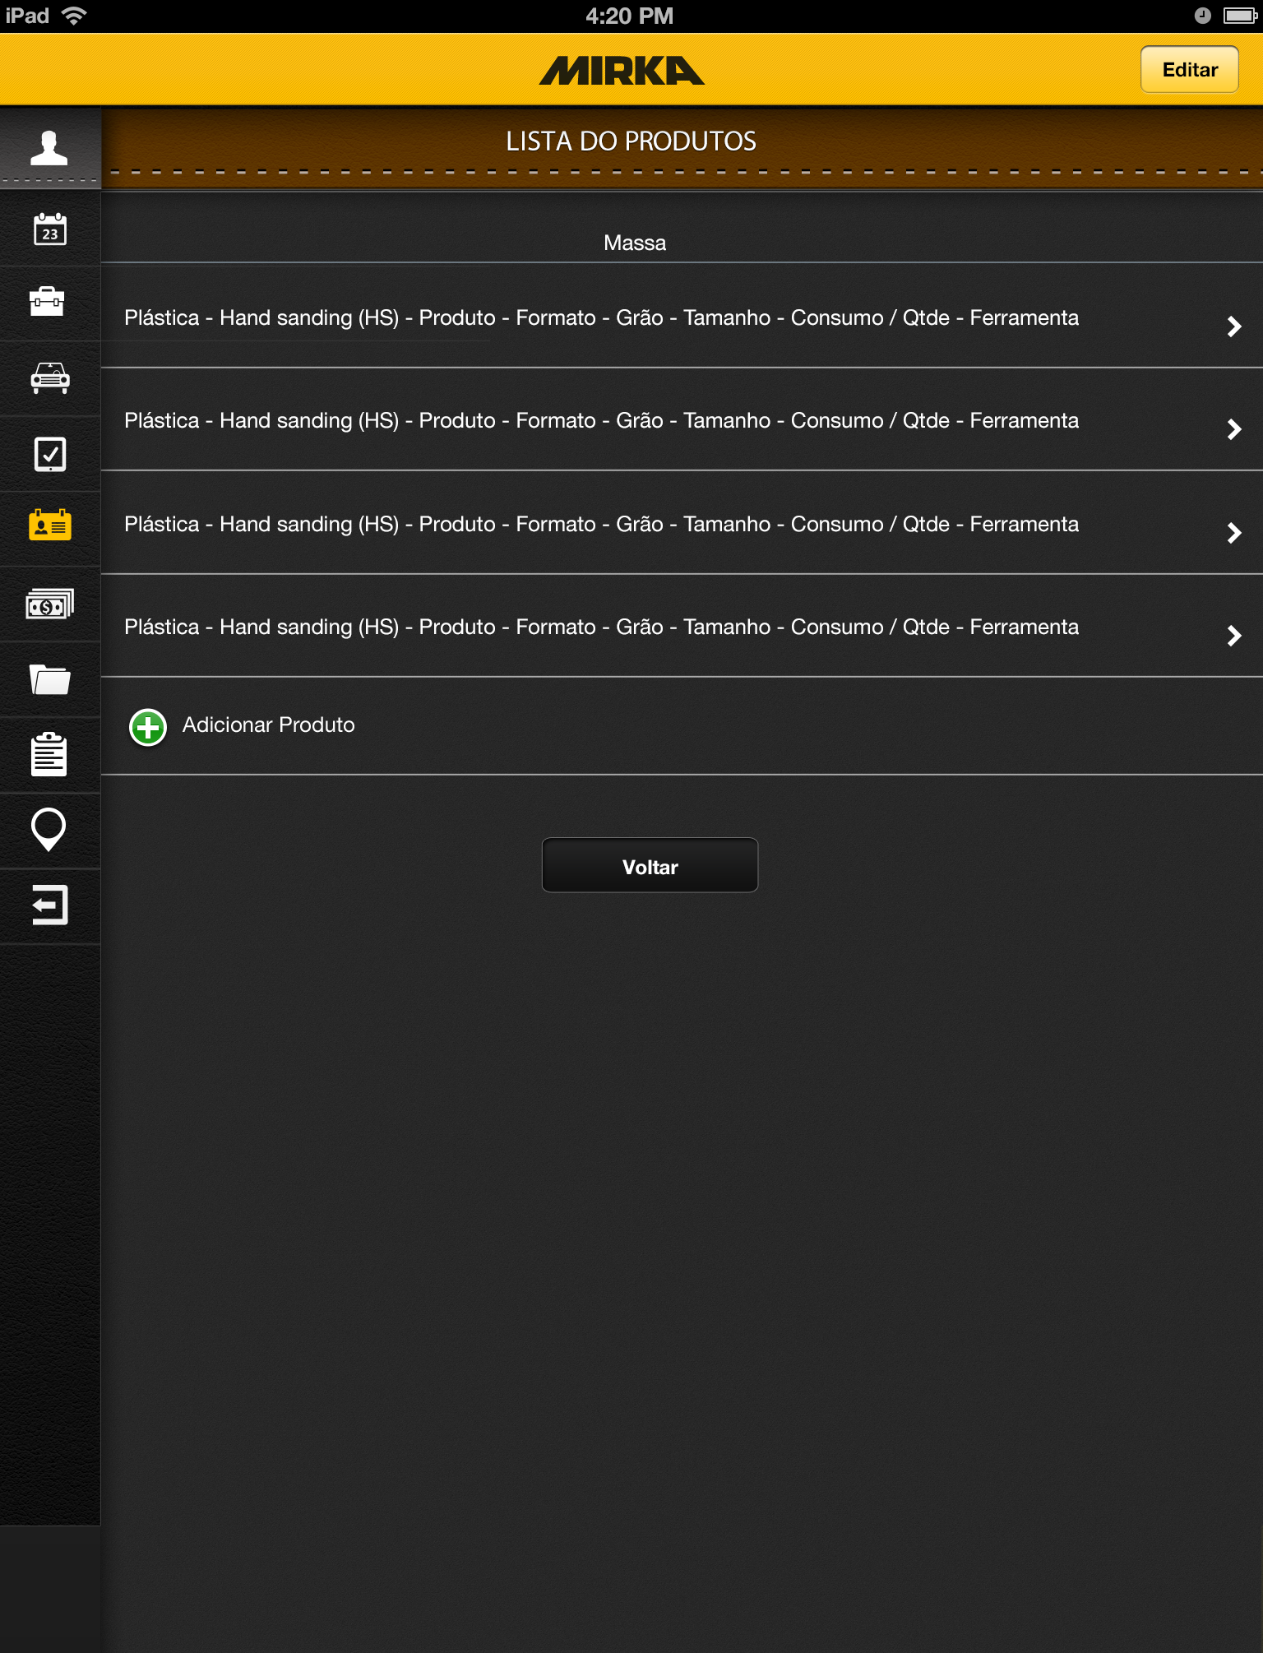
*Lista MassaTab
Takes you to *Lista Massa Editar Tab
Takes you to *Massa Tab with data
Autofilled with data from product
Takes you to *Massa Tab

Slide 41

*Lista Massa Editar Tab
Takes you to *lista Massa Tab
Deletes product
Takes you to *Massa Tab

Slide 42
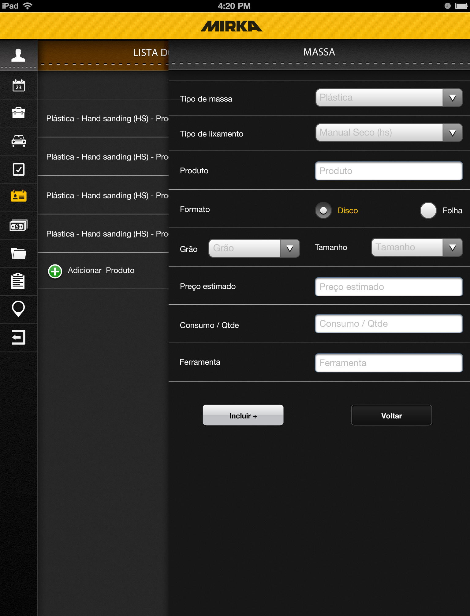
*Massa Tab
Drop down from backend
Open text field
Radio button
Drop down from backend
Open text fields
Adds product to list and
Clears fields

Slide 43

*Lista Primer Tab
Takes you to *Lista Primer Editar Tab
Takes you to *Primer Tab with data
Autofilled with data from product
Takes you to *Primer Tab

Slide 44

*Lista Primer Editar Tab
Takes you to *lista Primer Tab
Deletes product
Takes you to *Primer Tab

Slide 45
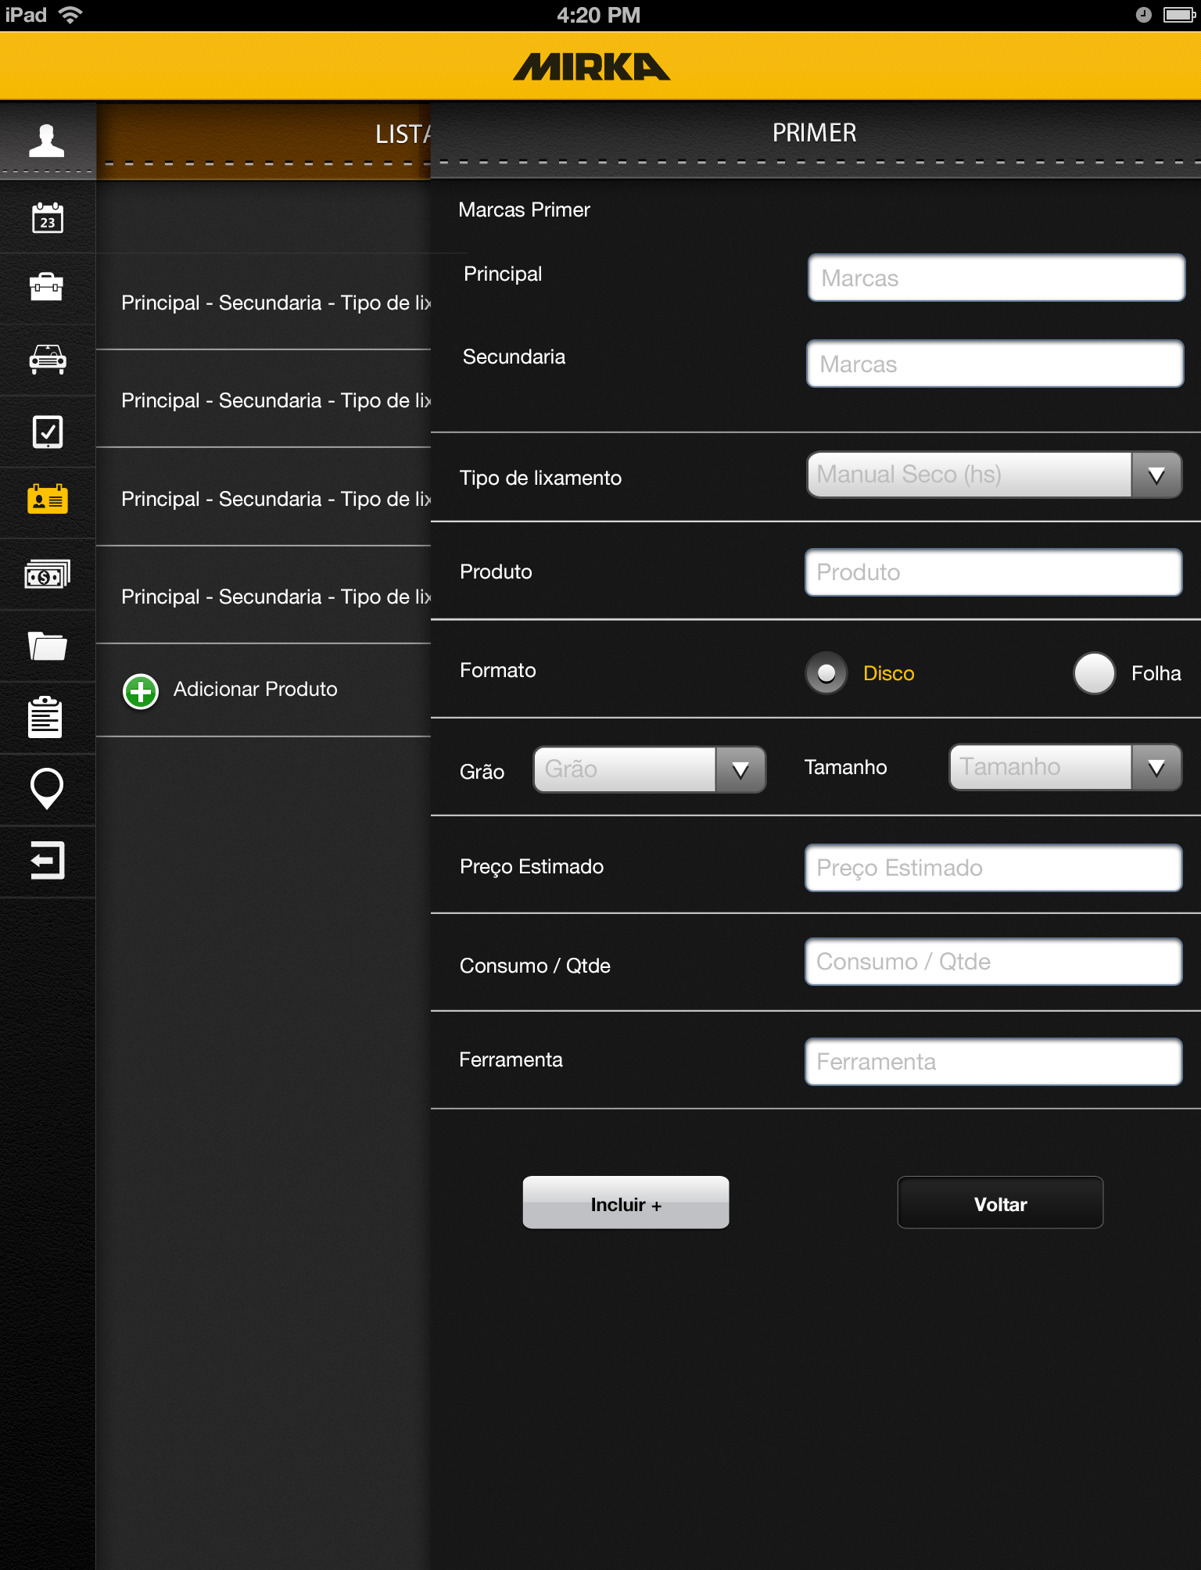
*Primer Tab
Open text fields
Drop down from backend
Open text field
Radio button
Drop down from backend
Open text fields
Adds product to list and
Clears fields

Slide 46
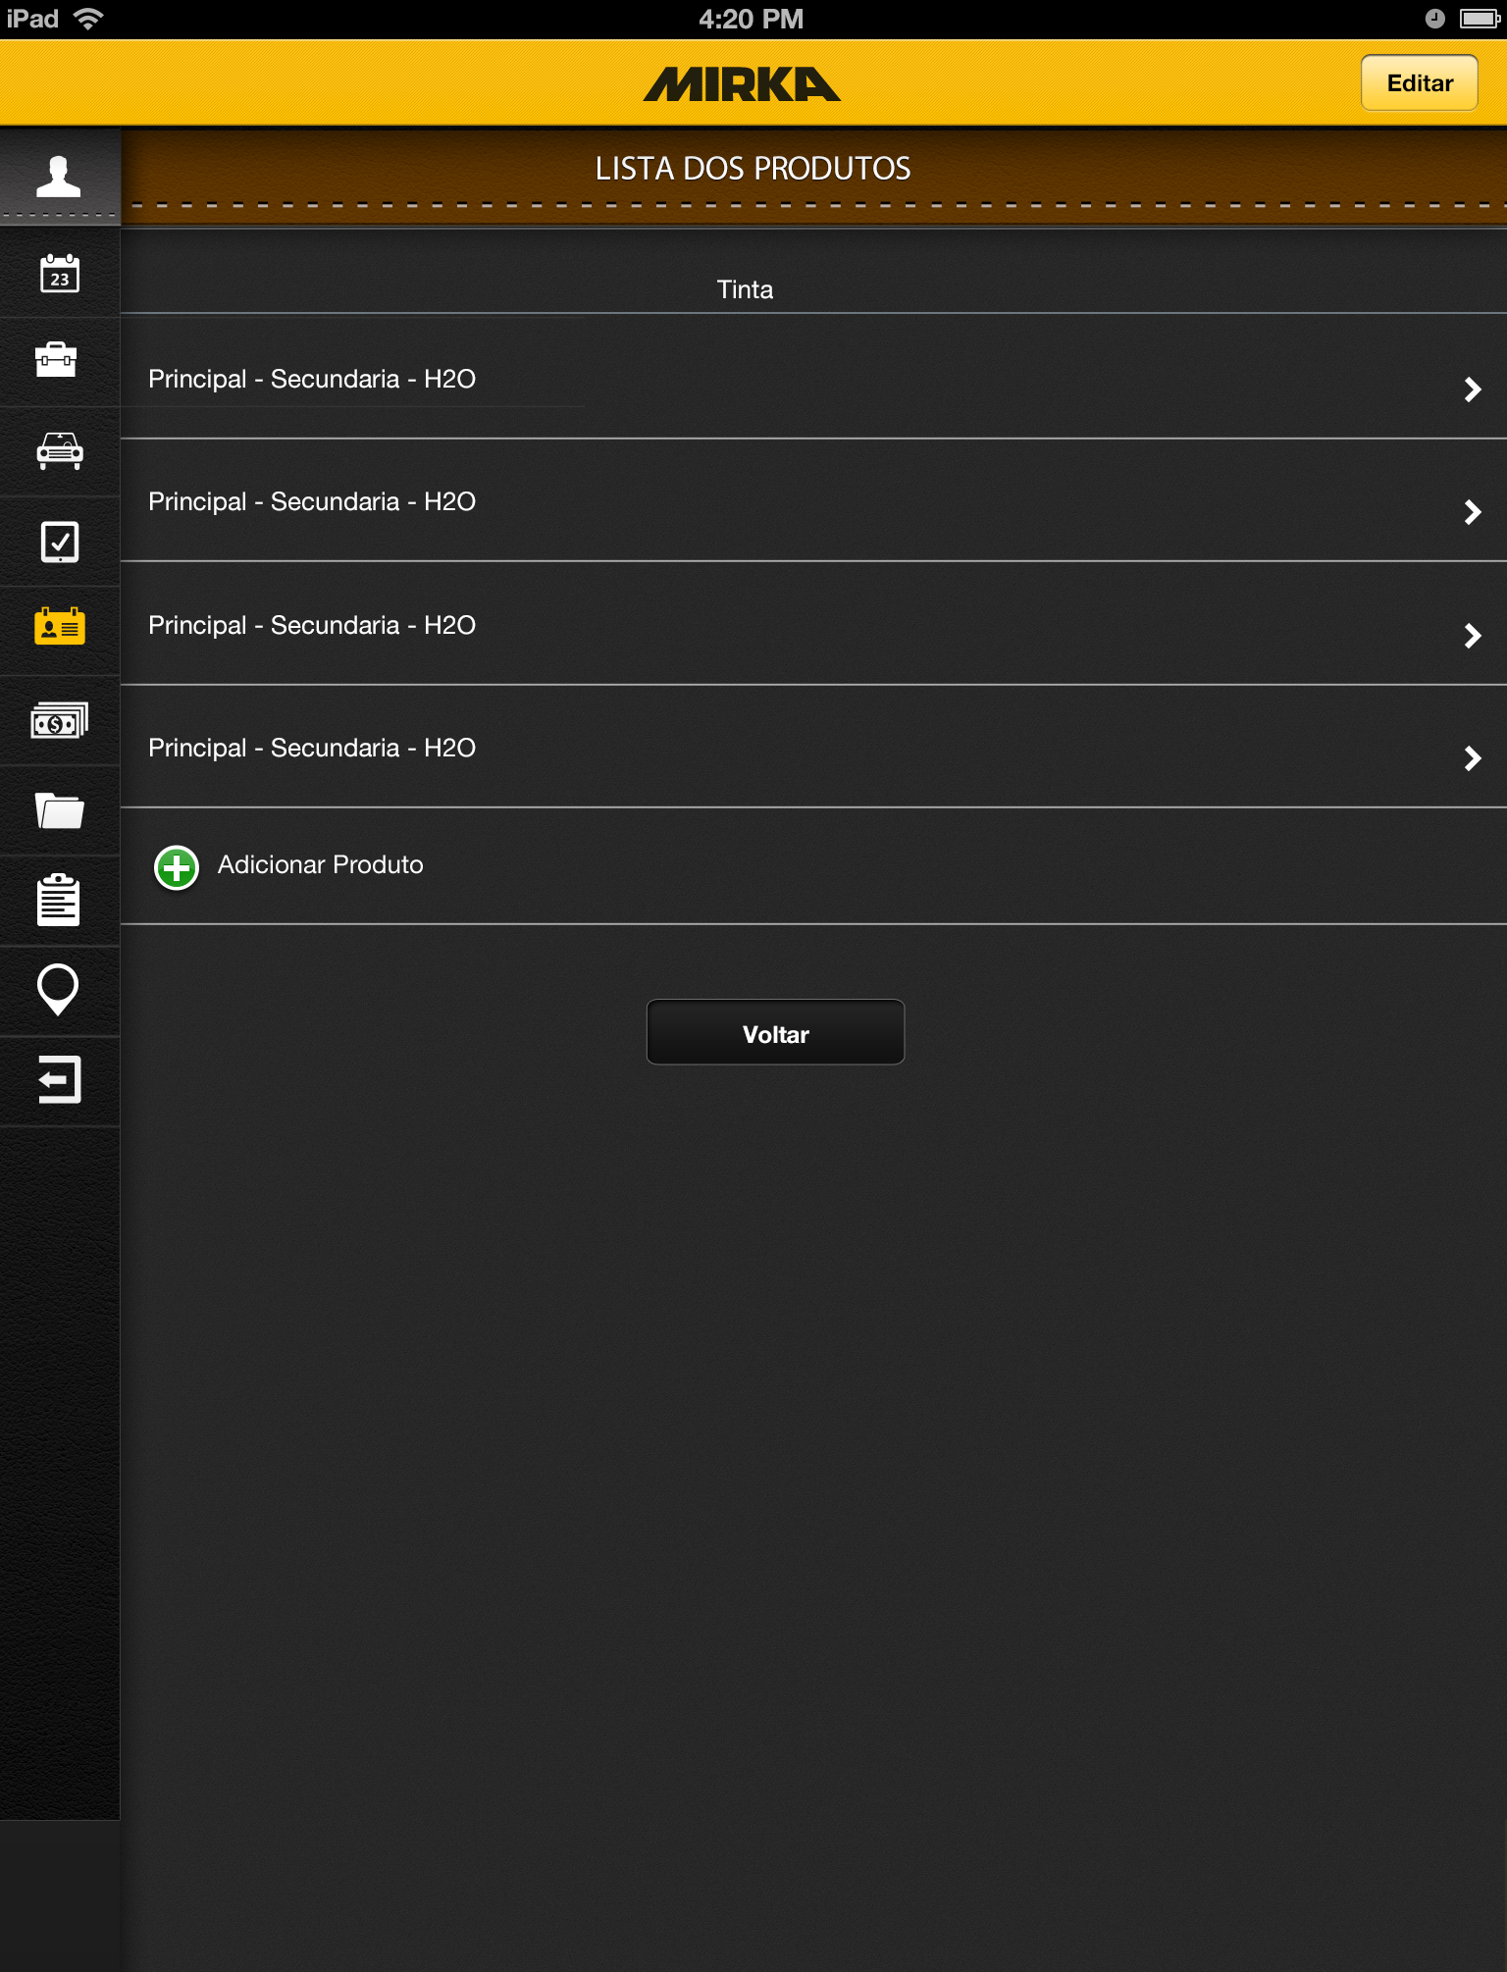
*Lista Tinta Tab
Takes you to *Lista Tinta Editar Tab
Takes you to *Tinta Tab with data
Autofilled with data from product
Takes you to *Tinta Tab

Slide 47
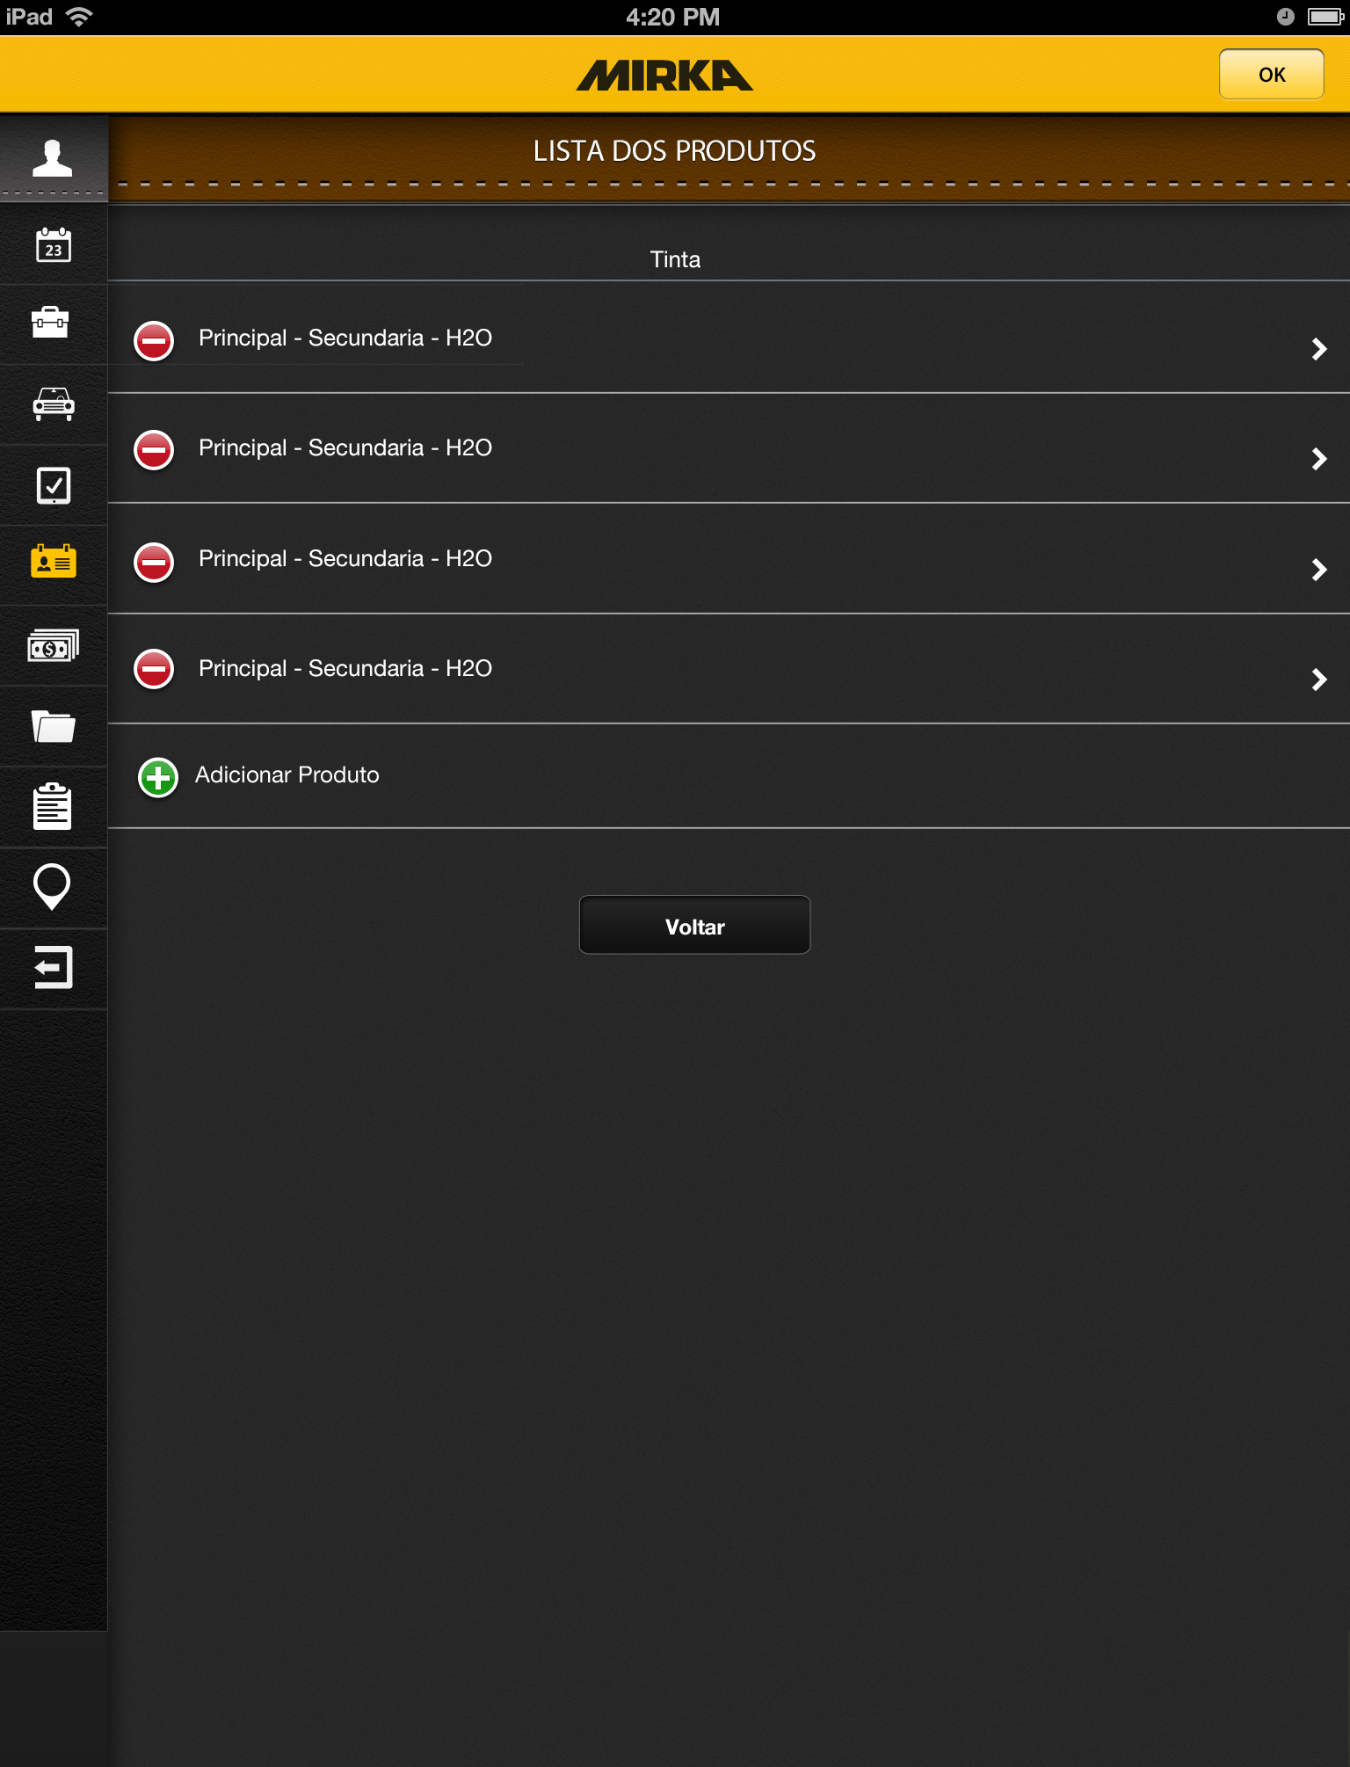
*Lista Tinta Editar Tab
Takes you to *Tinta metal Tab
Deletes product
Takes you to *Tinta Tab

Slide 48
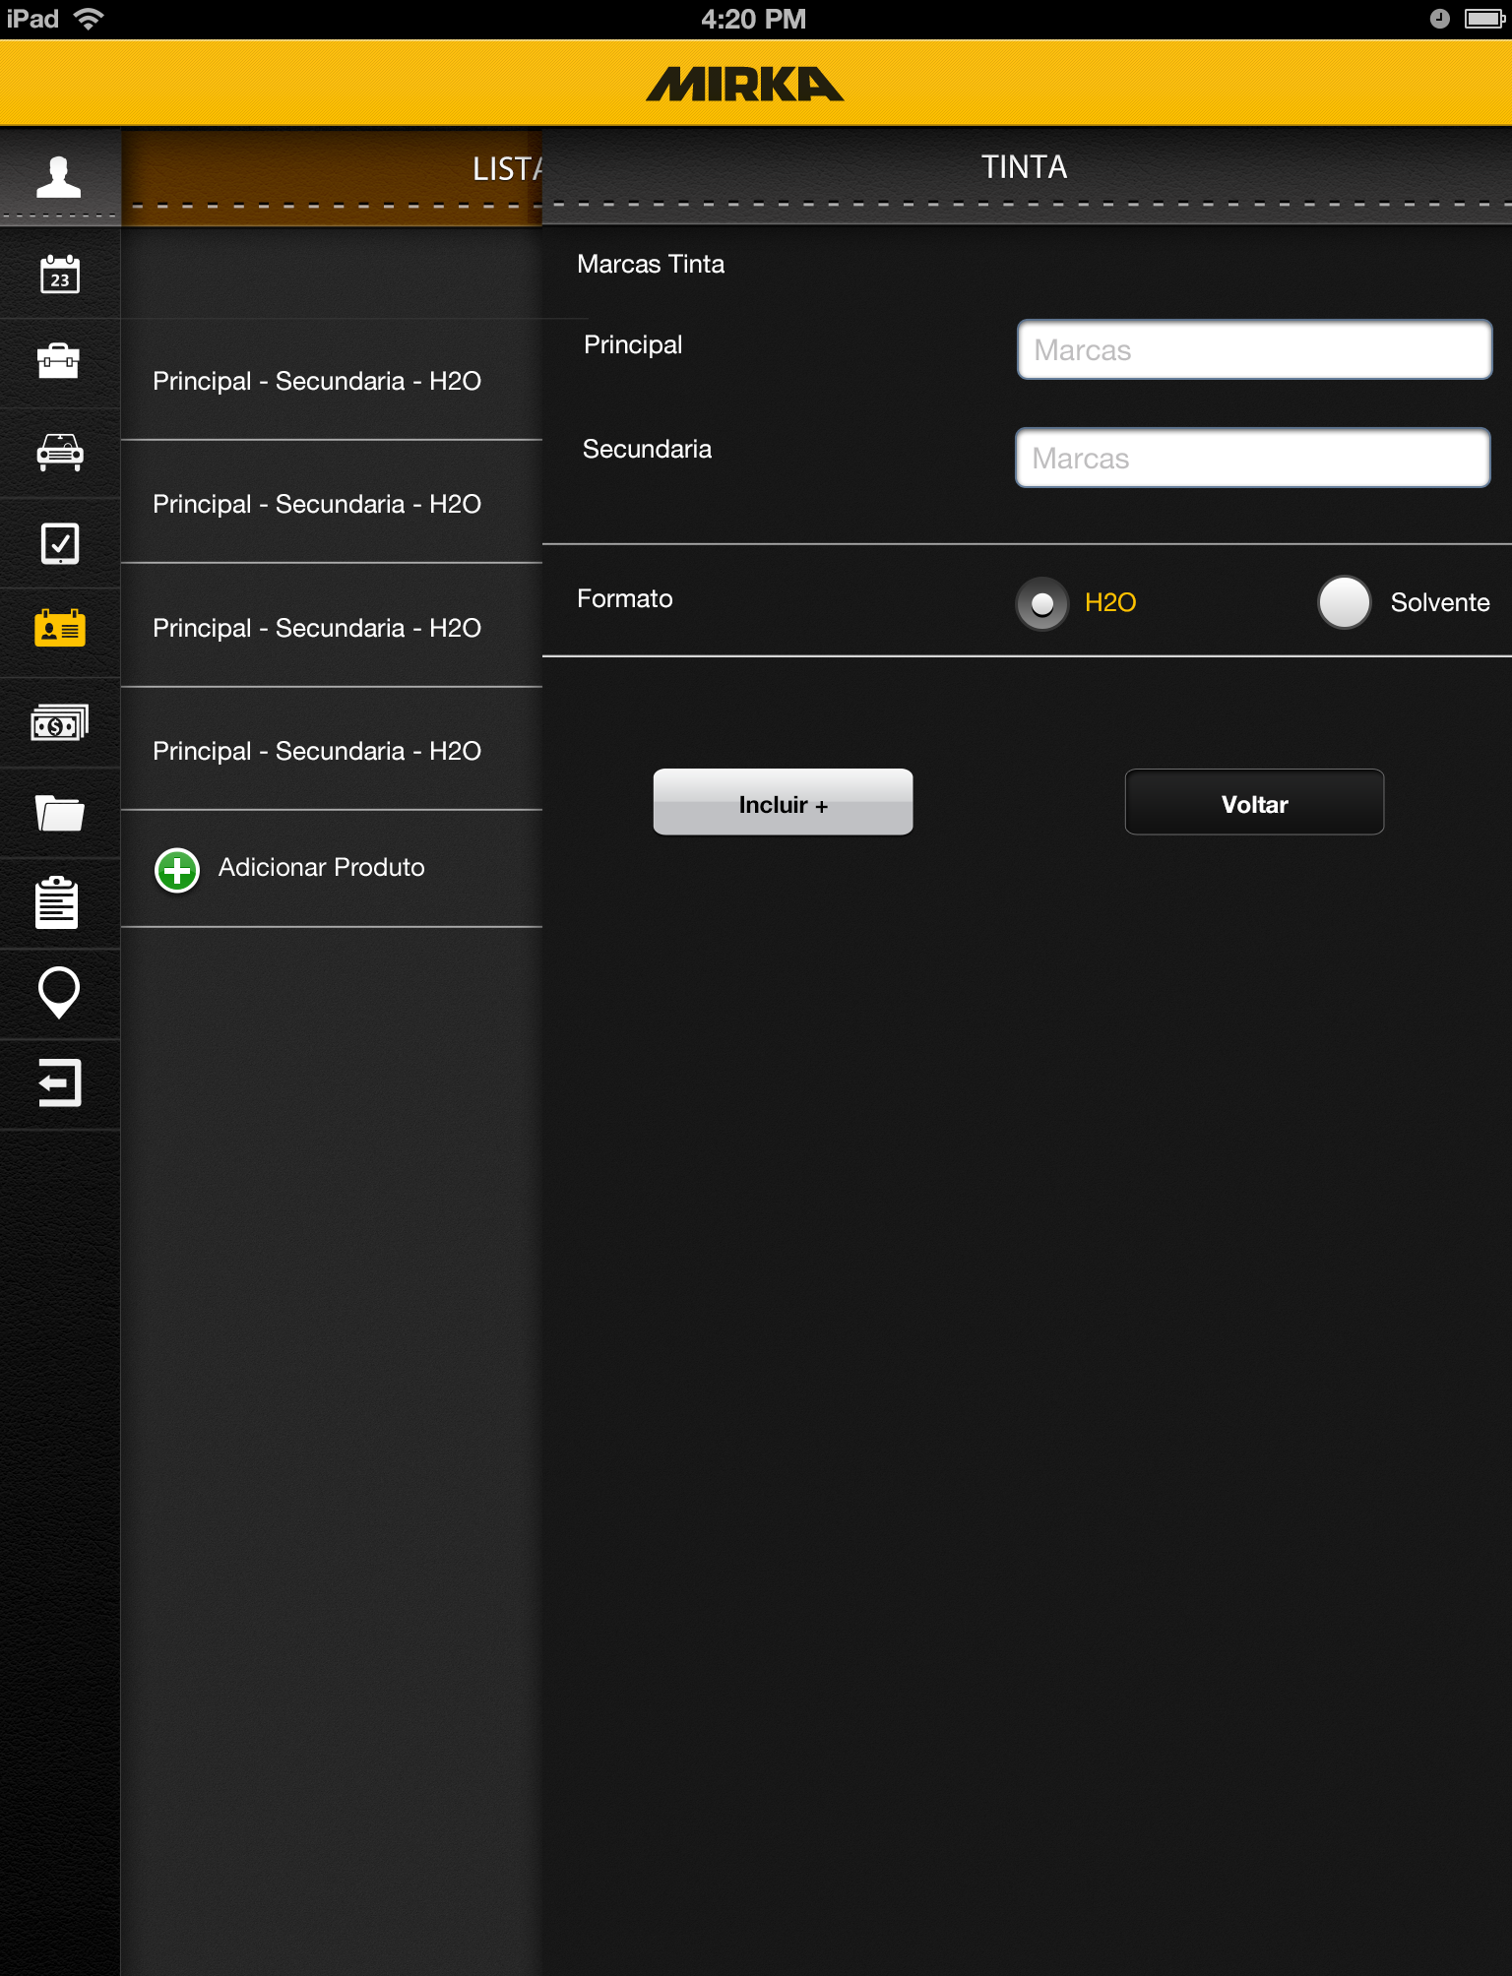
*Tinta Tab
Open text fields
Radio button
Adds product to list and
Clears fields

Slide 49

*Lista Verniz Tab
Takes you to *Lista Verniz Editar Tab
Takes you to *Verniz Tab with data
Autofilled with data from product
Takes you to *Verniz Tab

Slide 50

*Lista Verniz Editar Tab
Takes you to *Lista Verniz Tab
Deletes product
Takes you to *Verniz Tab

Slide 51

*Verniz Tab
Open text fields
Drop down from backend
Open text field
Radio button
Drop down from backend
Open text fields
Adds product to list and
Clears fields

Slide 52
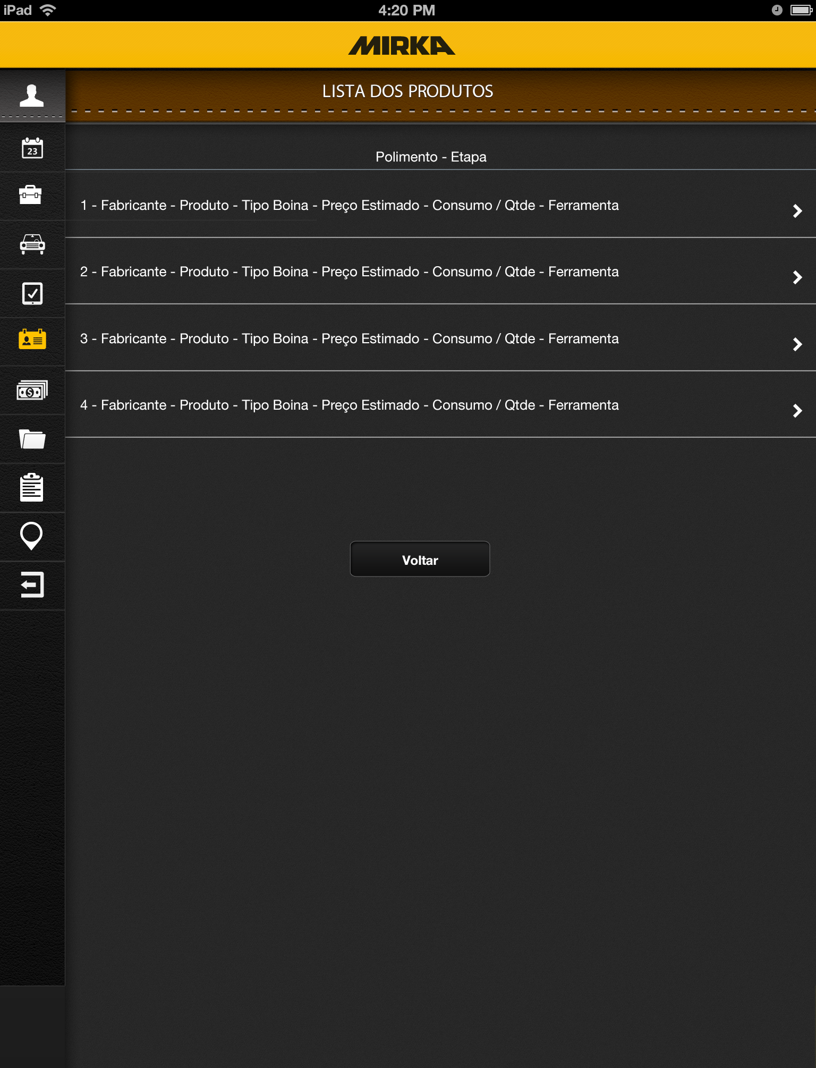
*Lista Polimento Tab
Takes you to *Verniz Tab with data
Autofilled with data from product input if
It has already been filled in the past

Slide 53
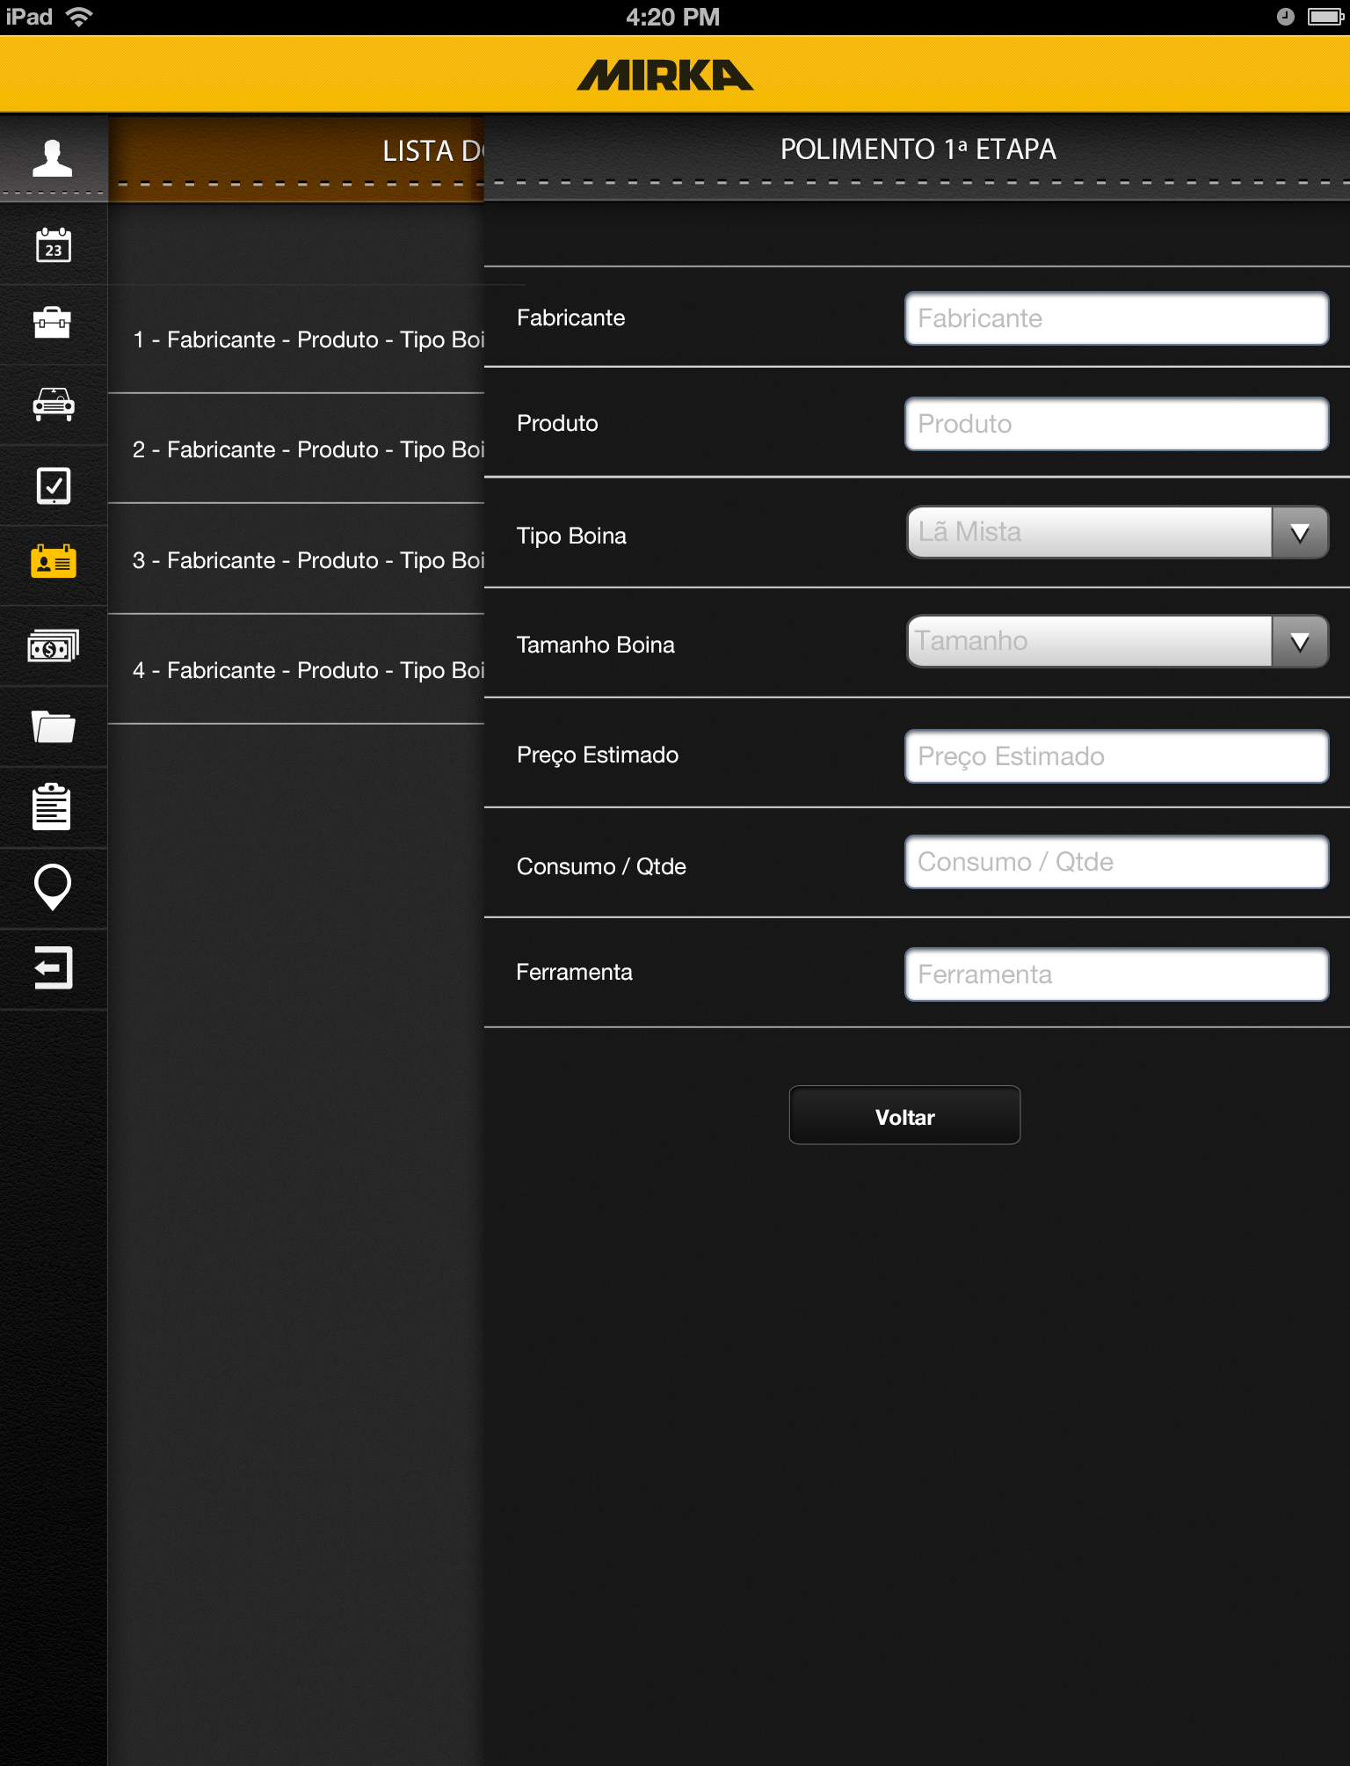
*Polimento Tab
Open text fields
Drop down from backend
Open text fields
Adds product to list and
Clears fields

